Slide 1
Picture This: Then and Now
Introduction
Thk e■hlbtt.lon ren.ct• tn,eyeoAoftheaw.op
A...cikmdtt.riloge ActionZ- o, ltA.l &e.-hatls
,-,t1:41pond wt,ot I••Ad'°"l0f"Mf1
-
'
'

Slide 2
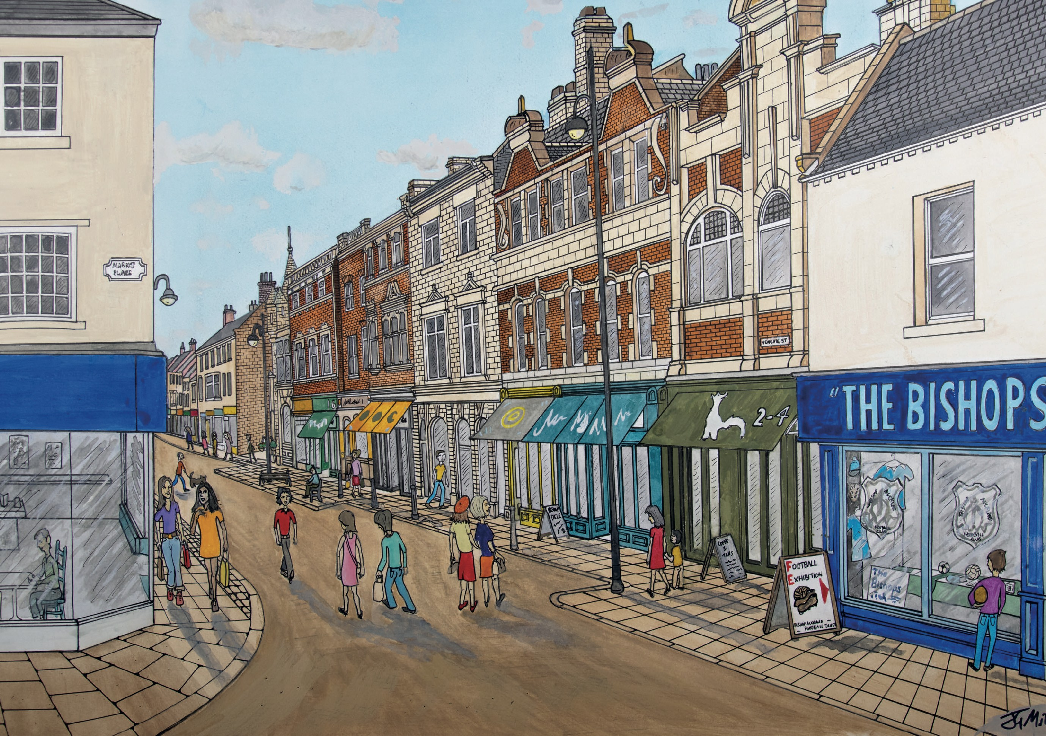

Slide 3
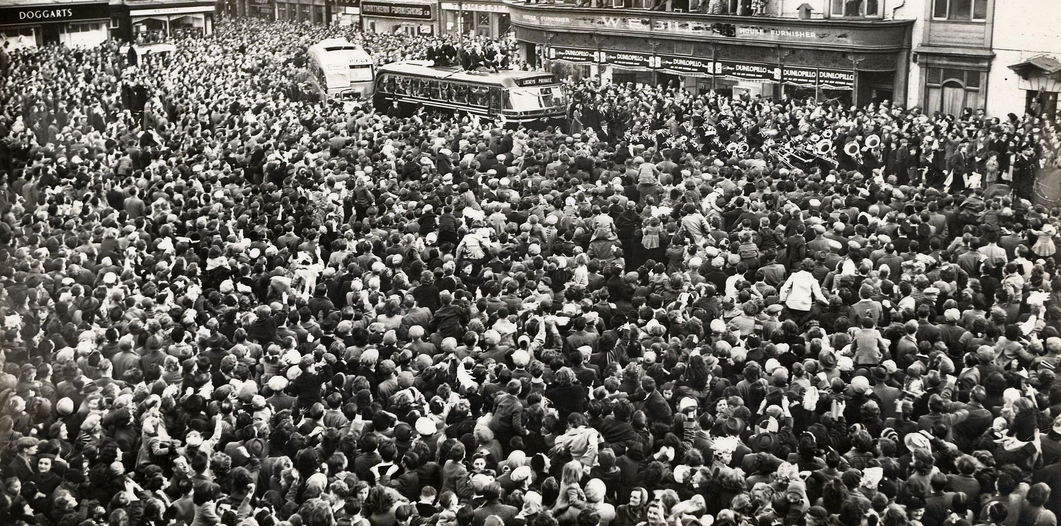

Slide 4
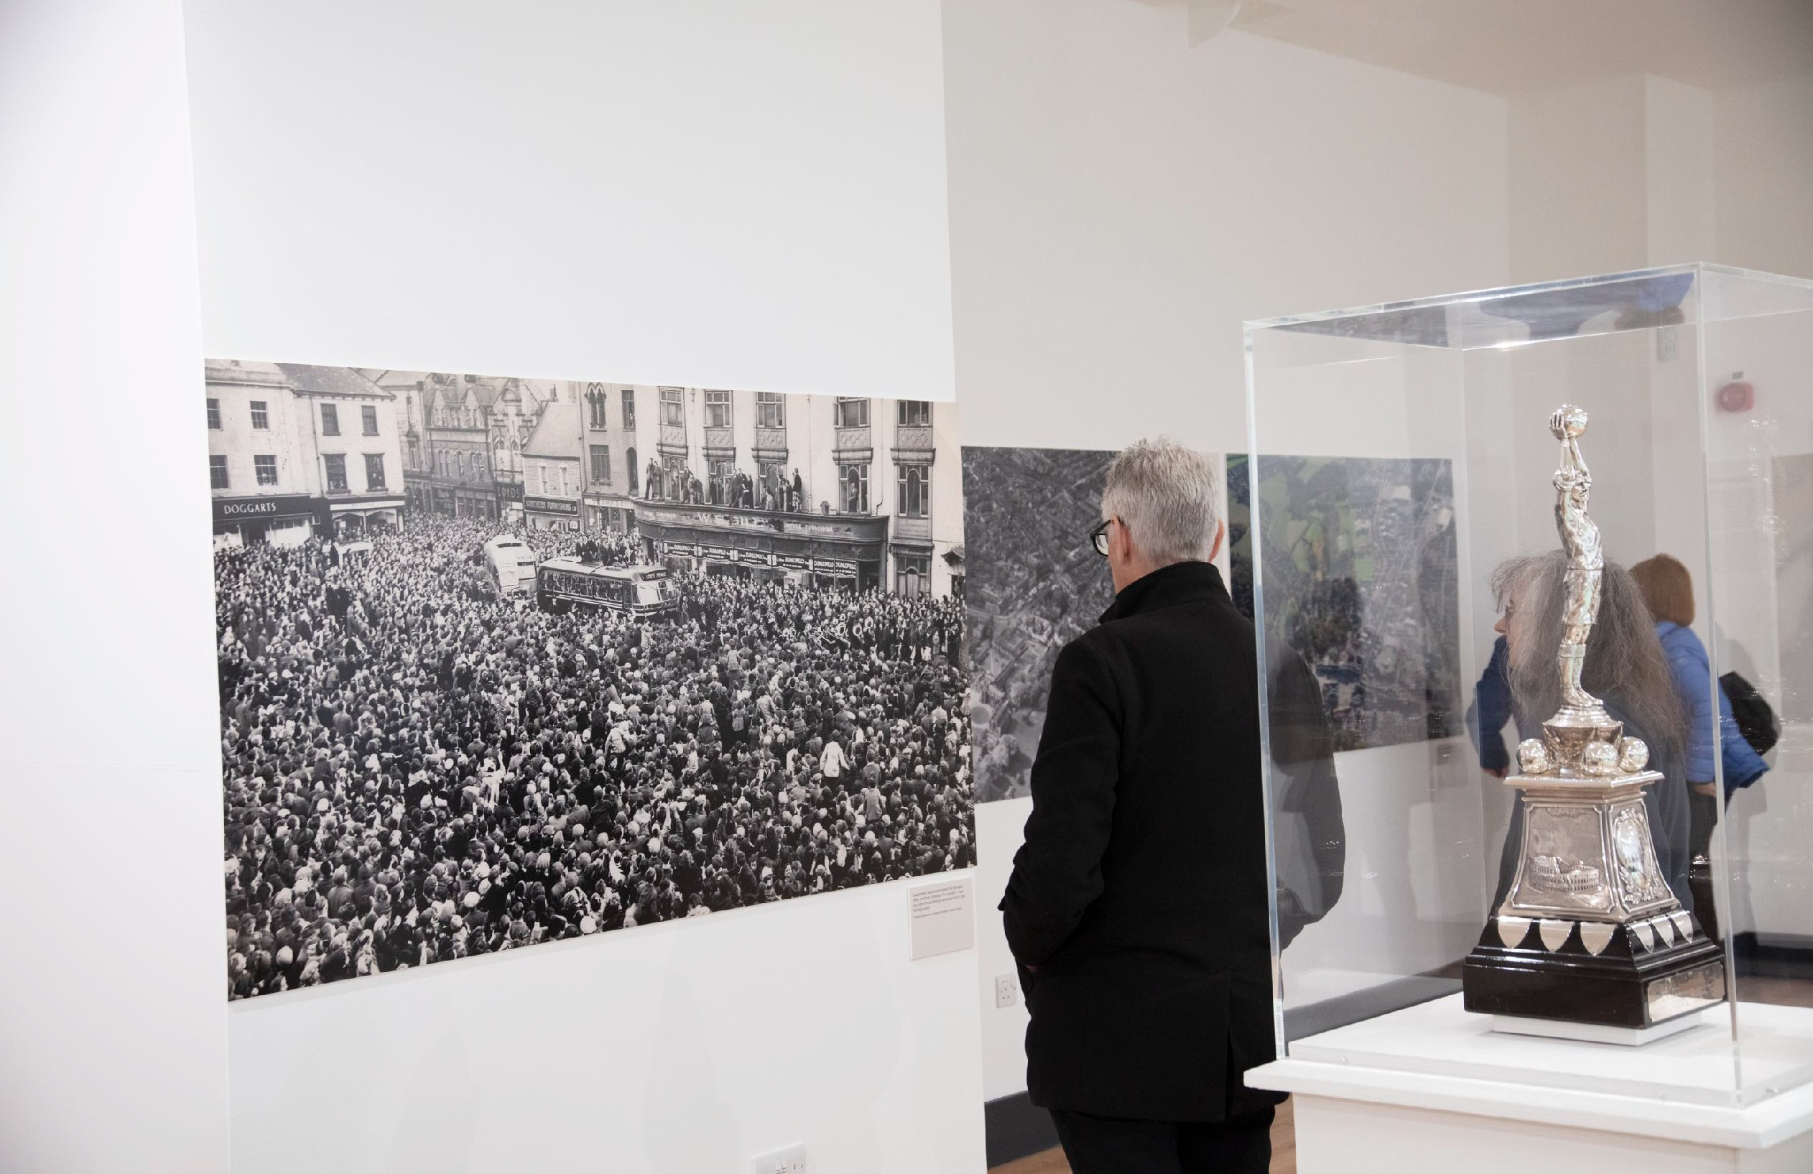

Slide 5
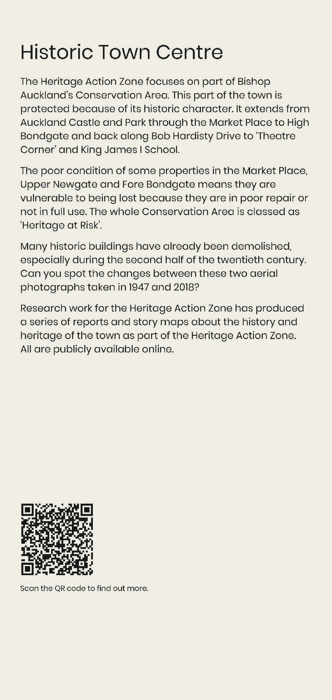
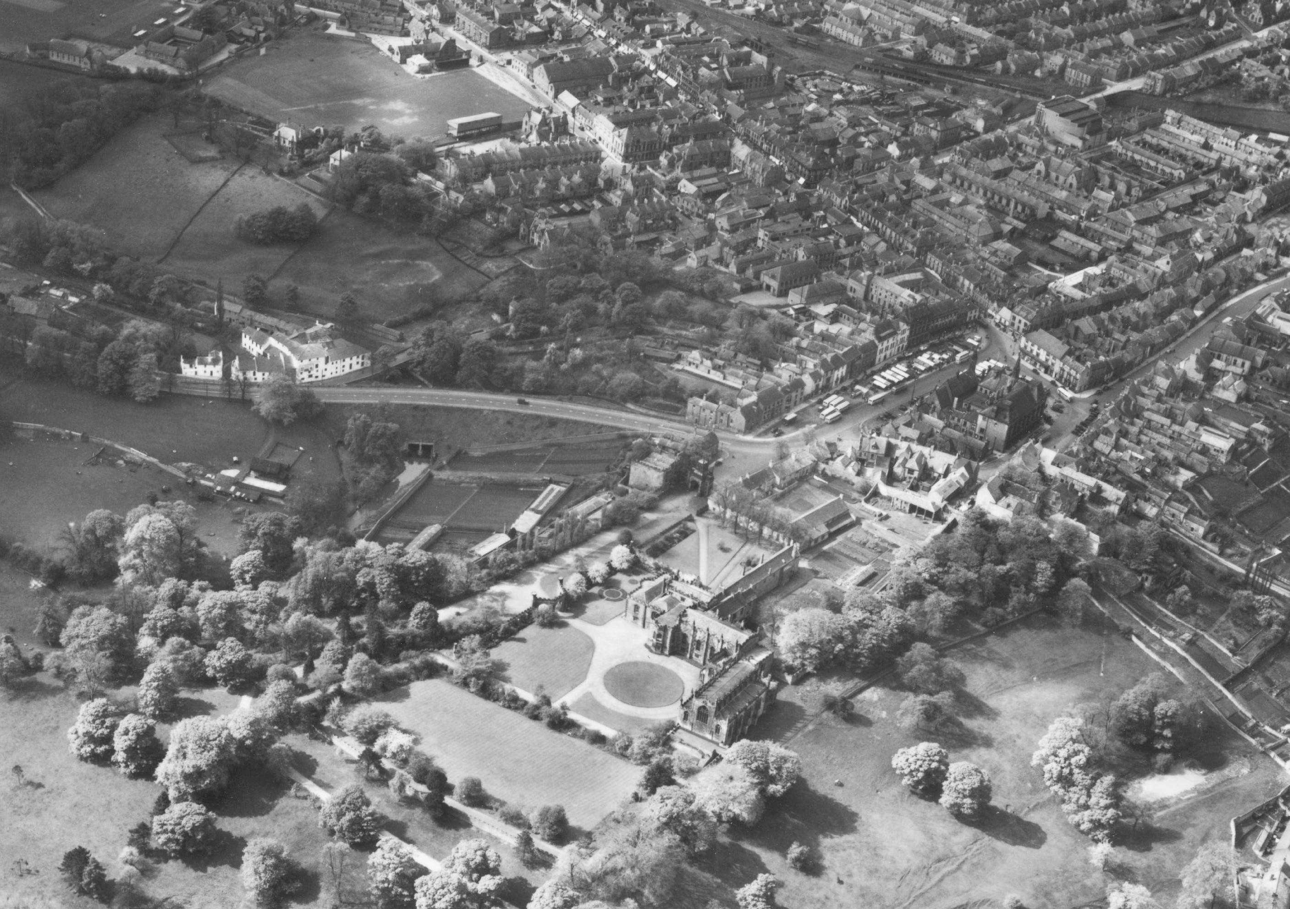

Slide 6
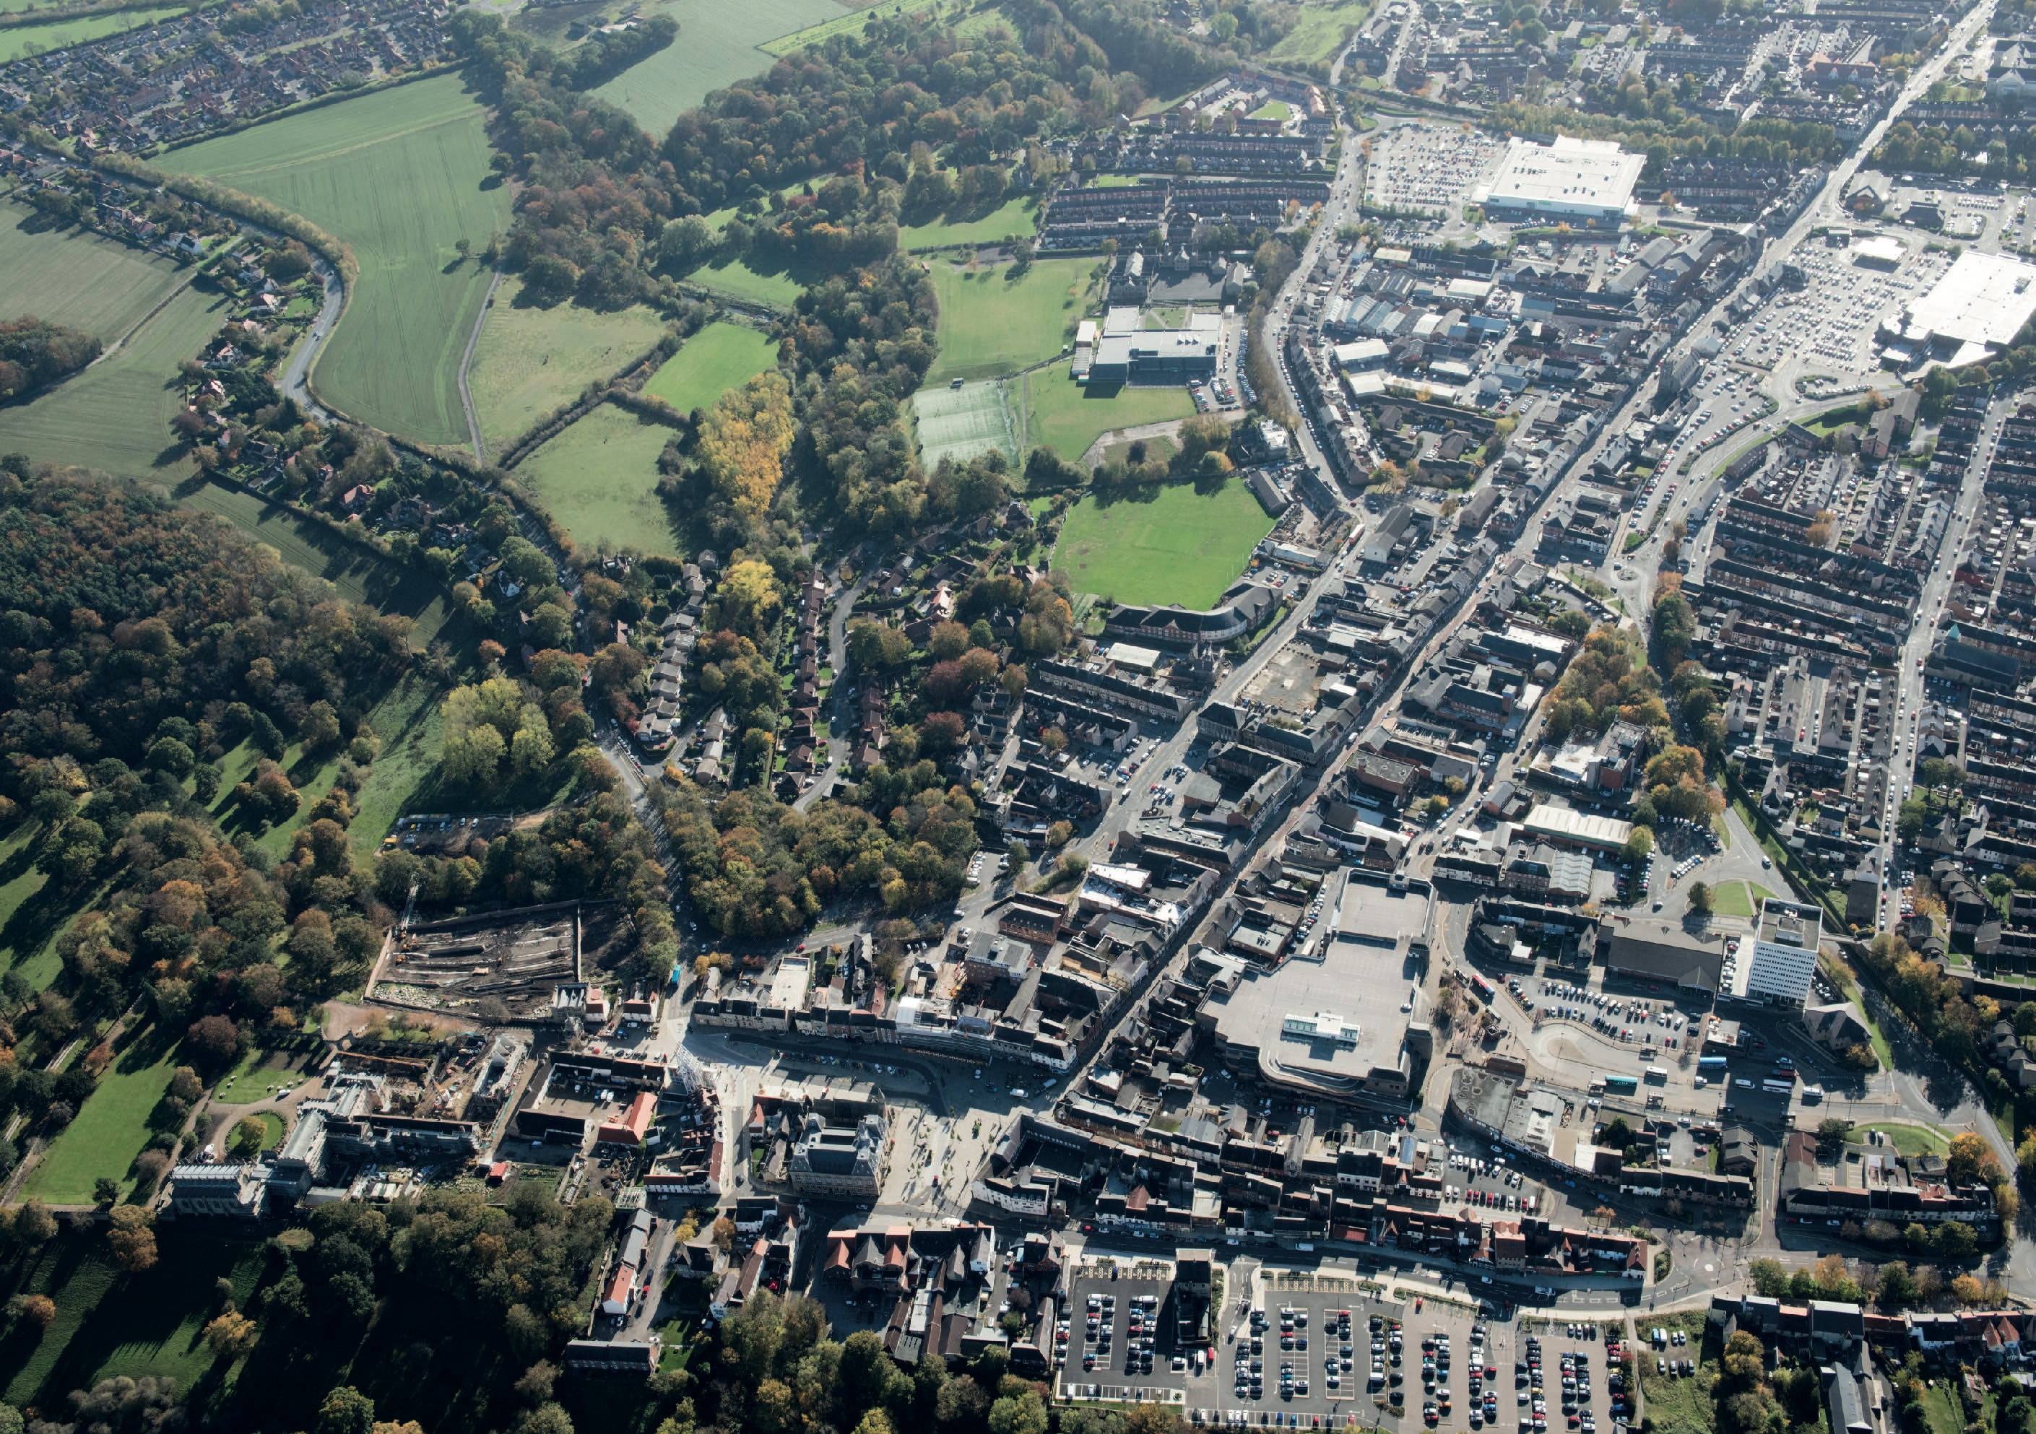

Slide 7
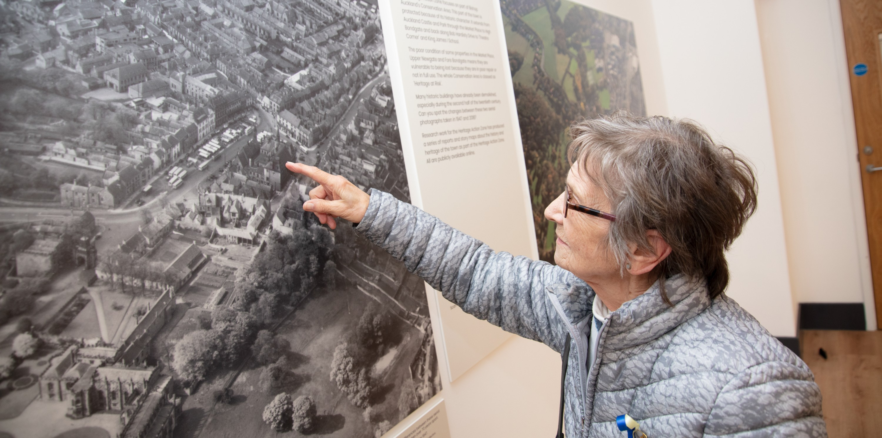
Spot the differences between these aerial photographs taken over 70 years apart. Bishop Auckland, 17 May 1947.
© Historic England Archive, Aerofilms Collection, Ref EAW005553 Flight AFL19470517.

Slide 8
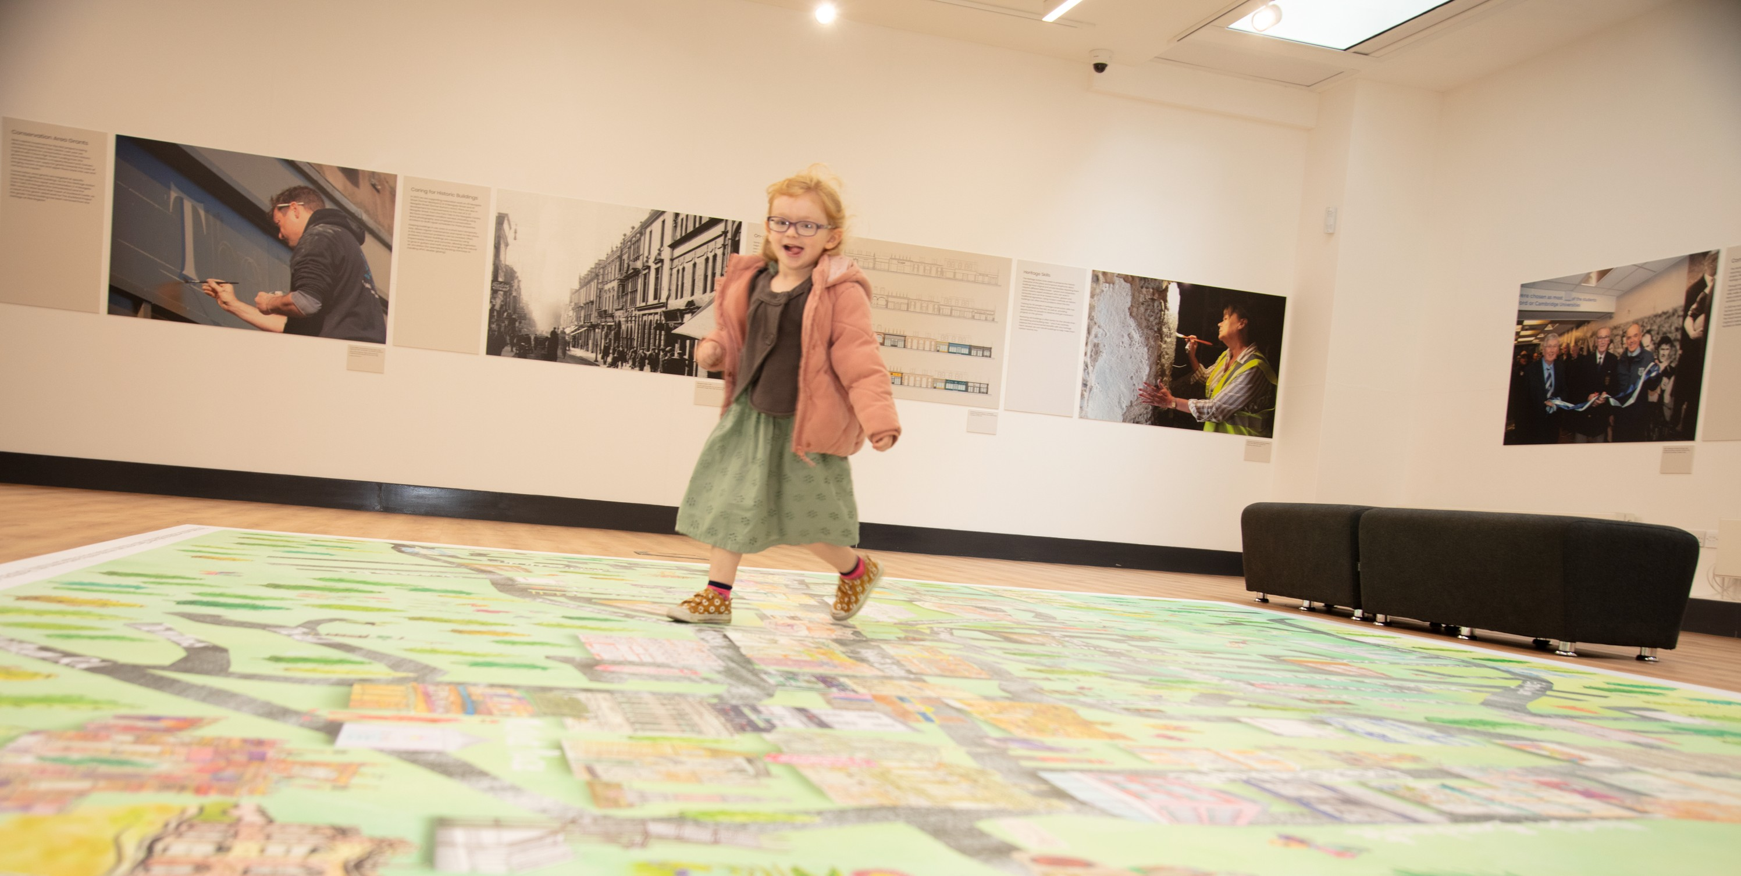
‘On the Map’ was co-created by textile artist Gillian Arnold with schools and the local community. Hundreds of people were involved in drawing buildings, cultural landmarks, people, items and objects to bring Bishop Auckland to life in a new and artistic way.

Slide 9
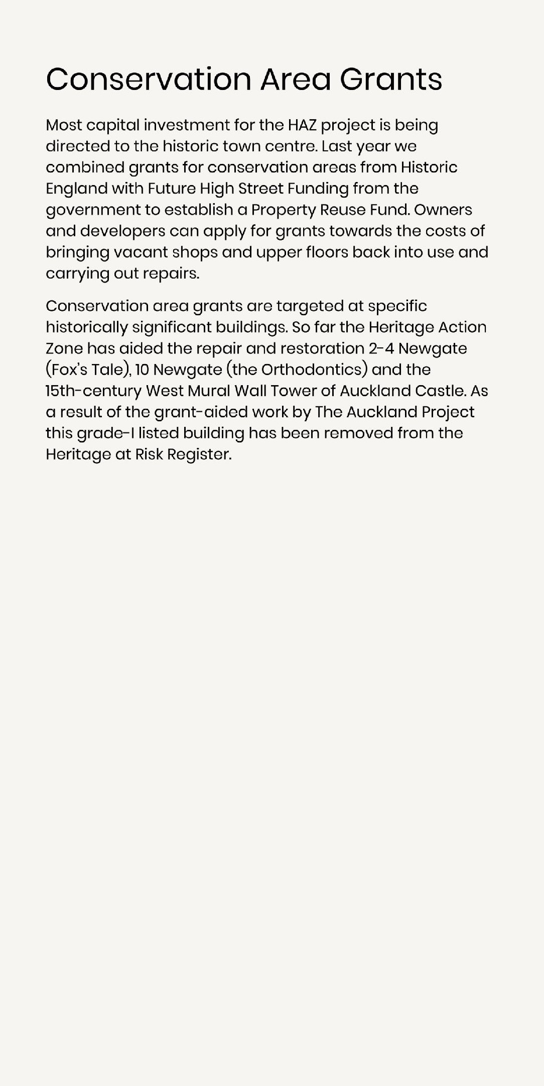
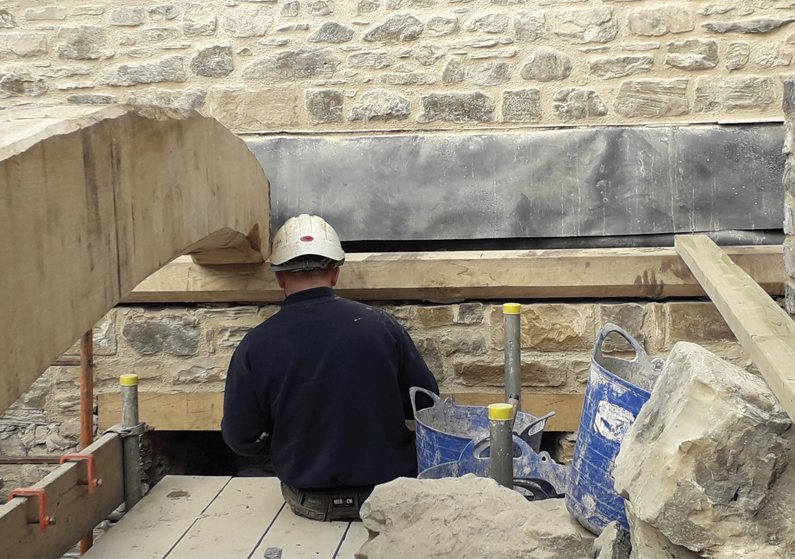
A contractor from Heritage Consolidation Ltd at work on the West Mural Wall Tower of Auckland Castle.

Slide 10
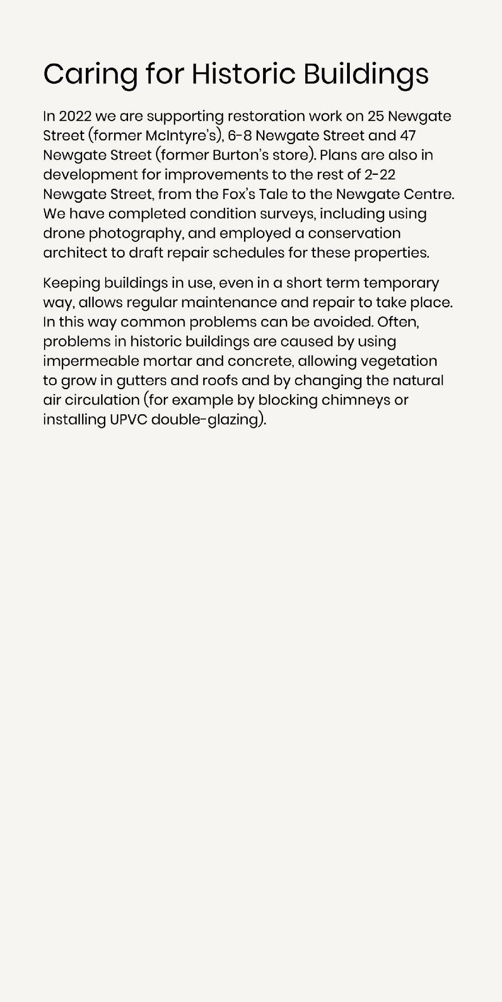
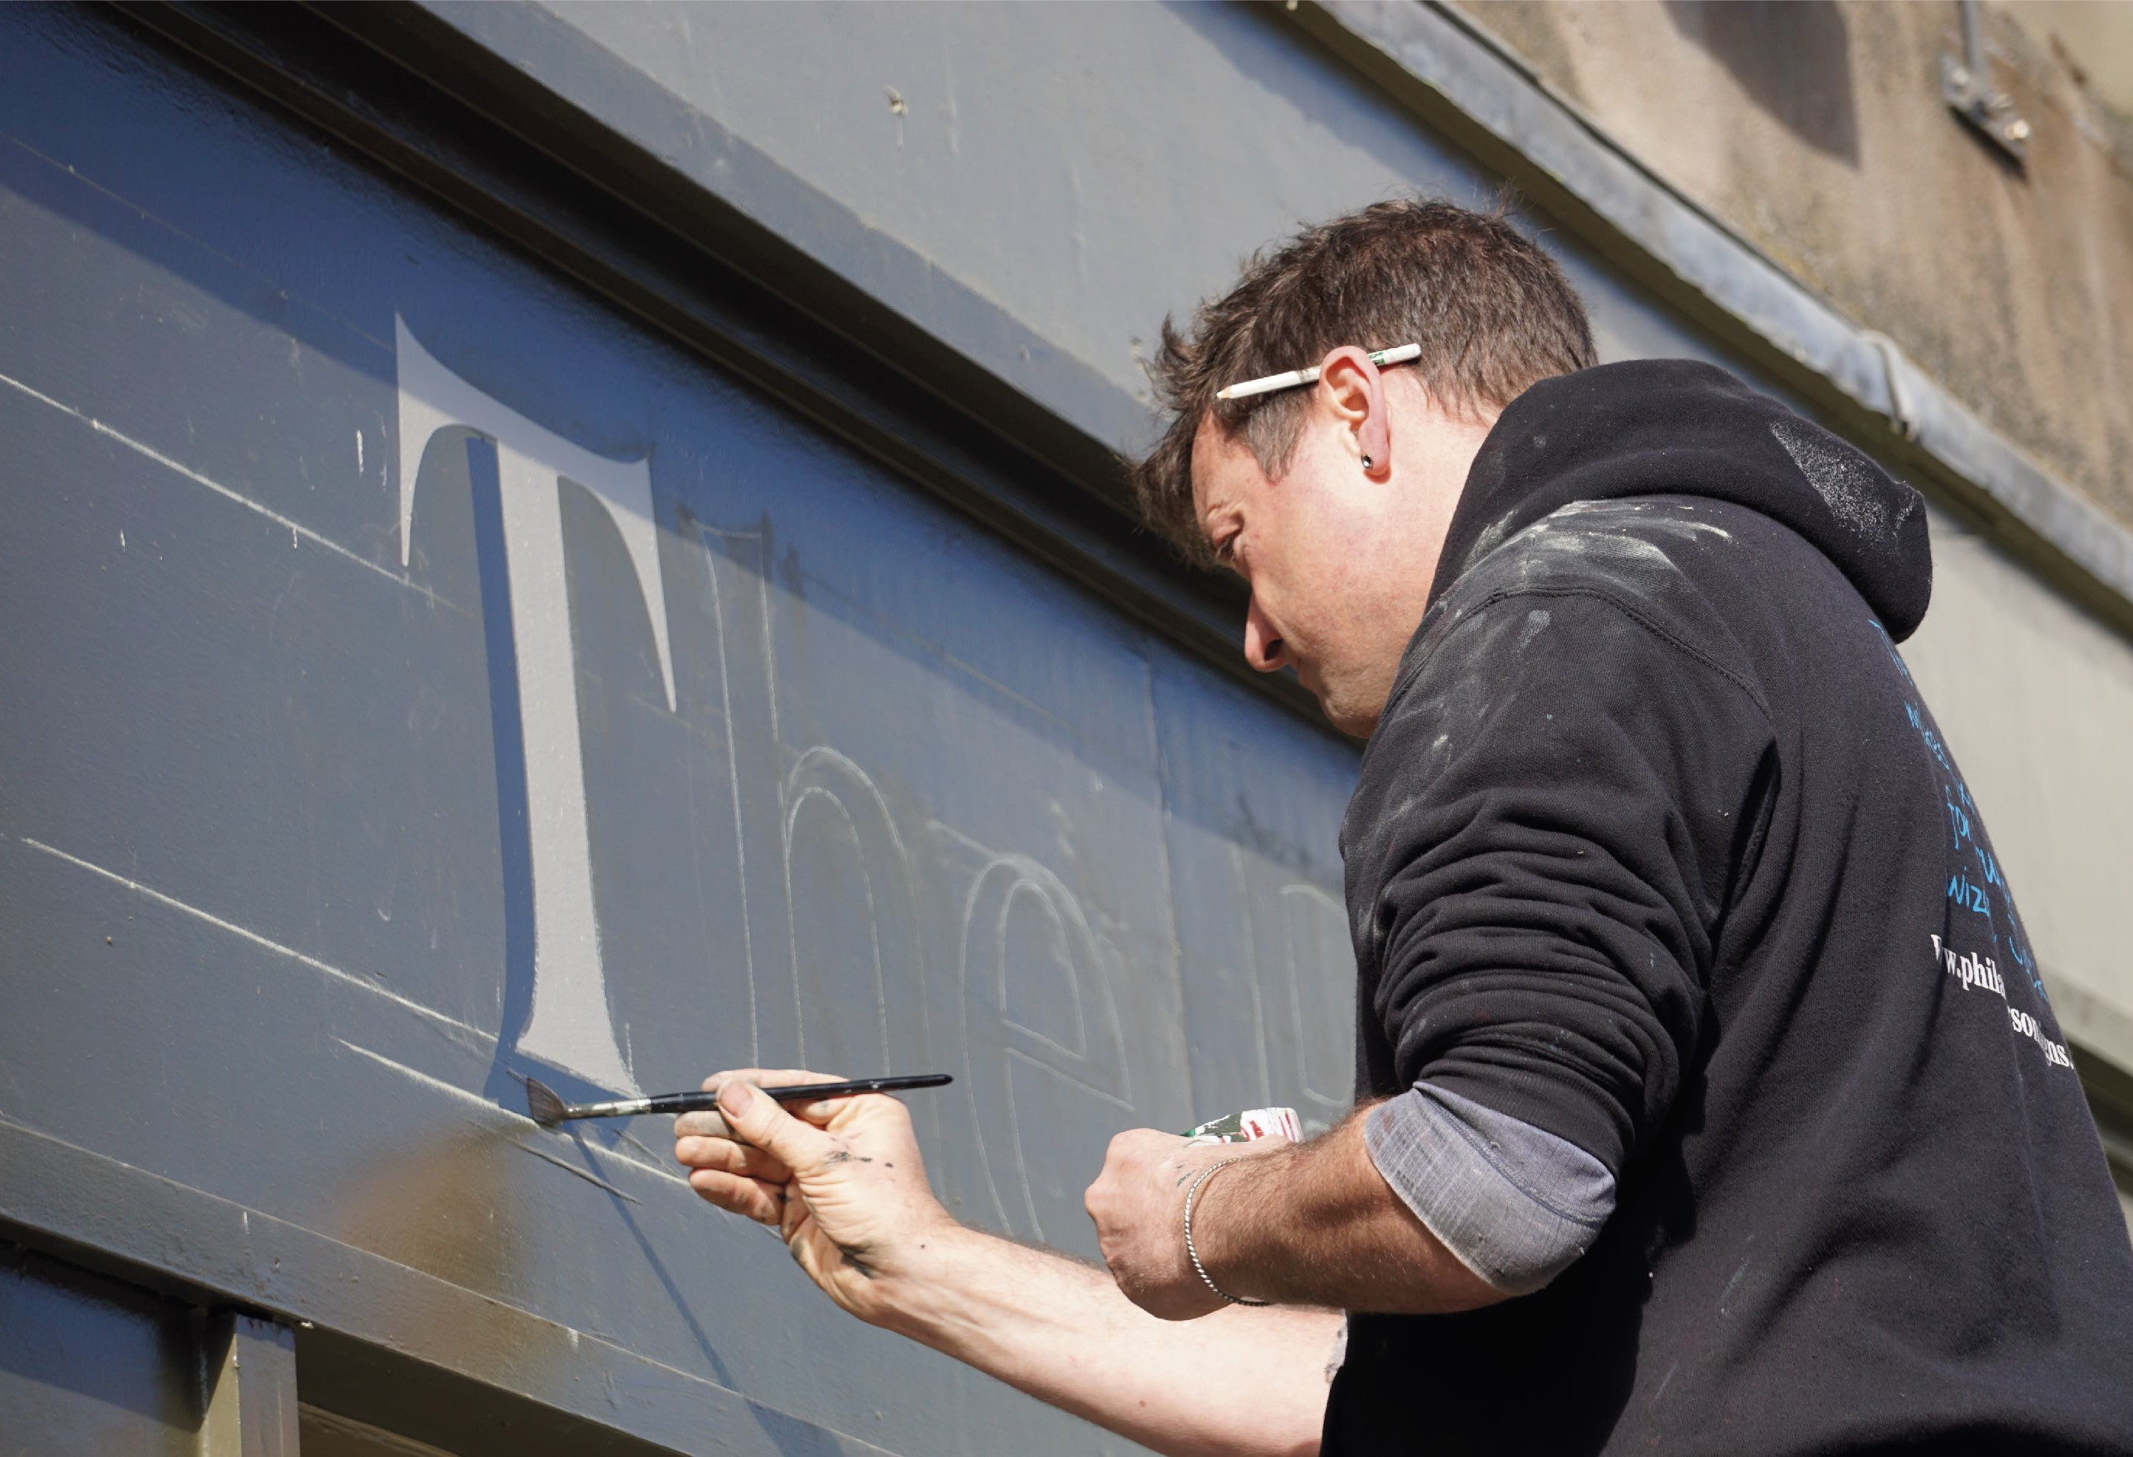
In the 1980s handpainted shop signs were replaced with computer cut plastic graphics. Here Phil Anderson Signs demonstrate traditional techniques at the Fox’s Tale. Image by Elaine Vizor.

Slide 11
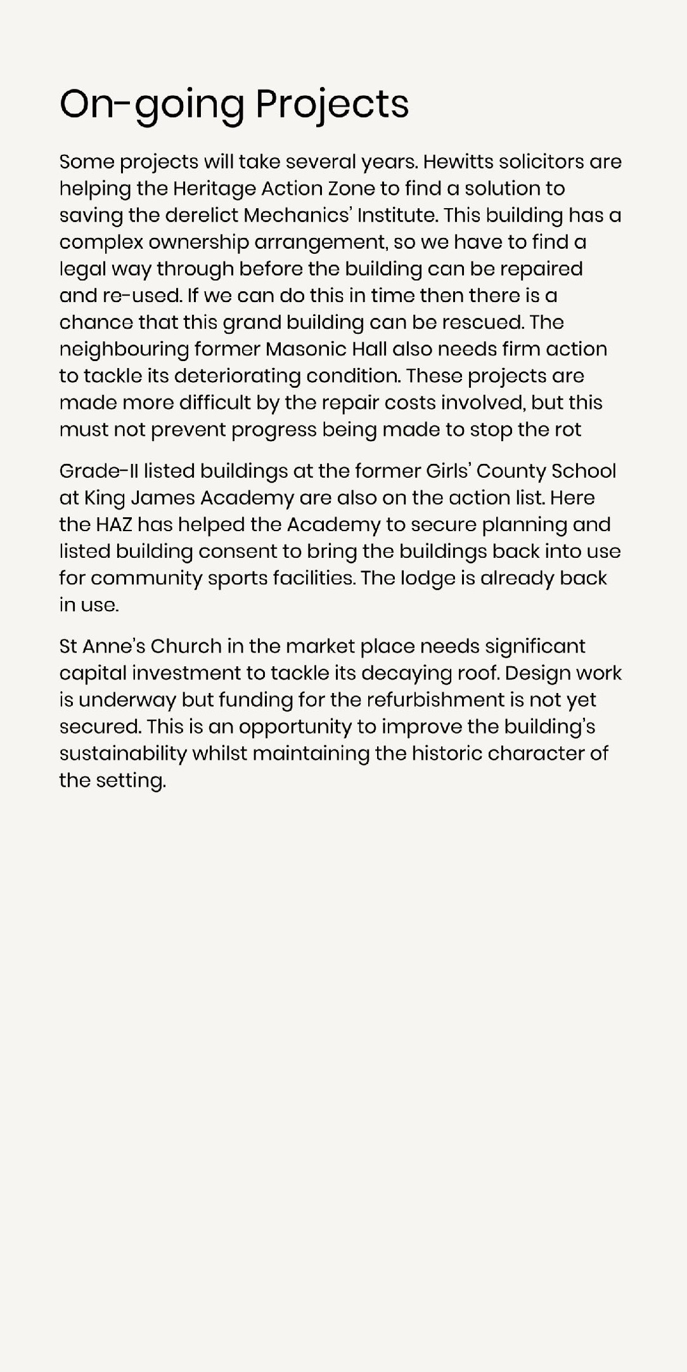
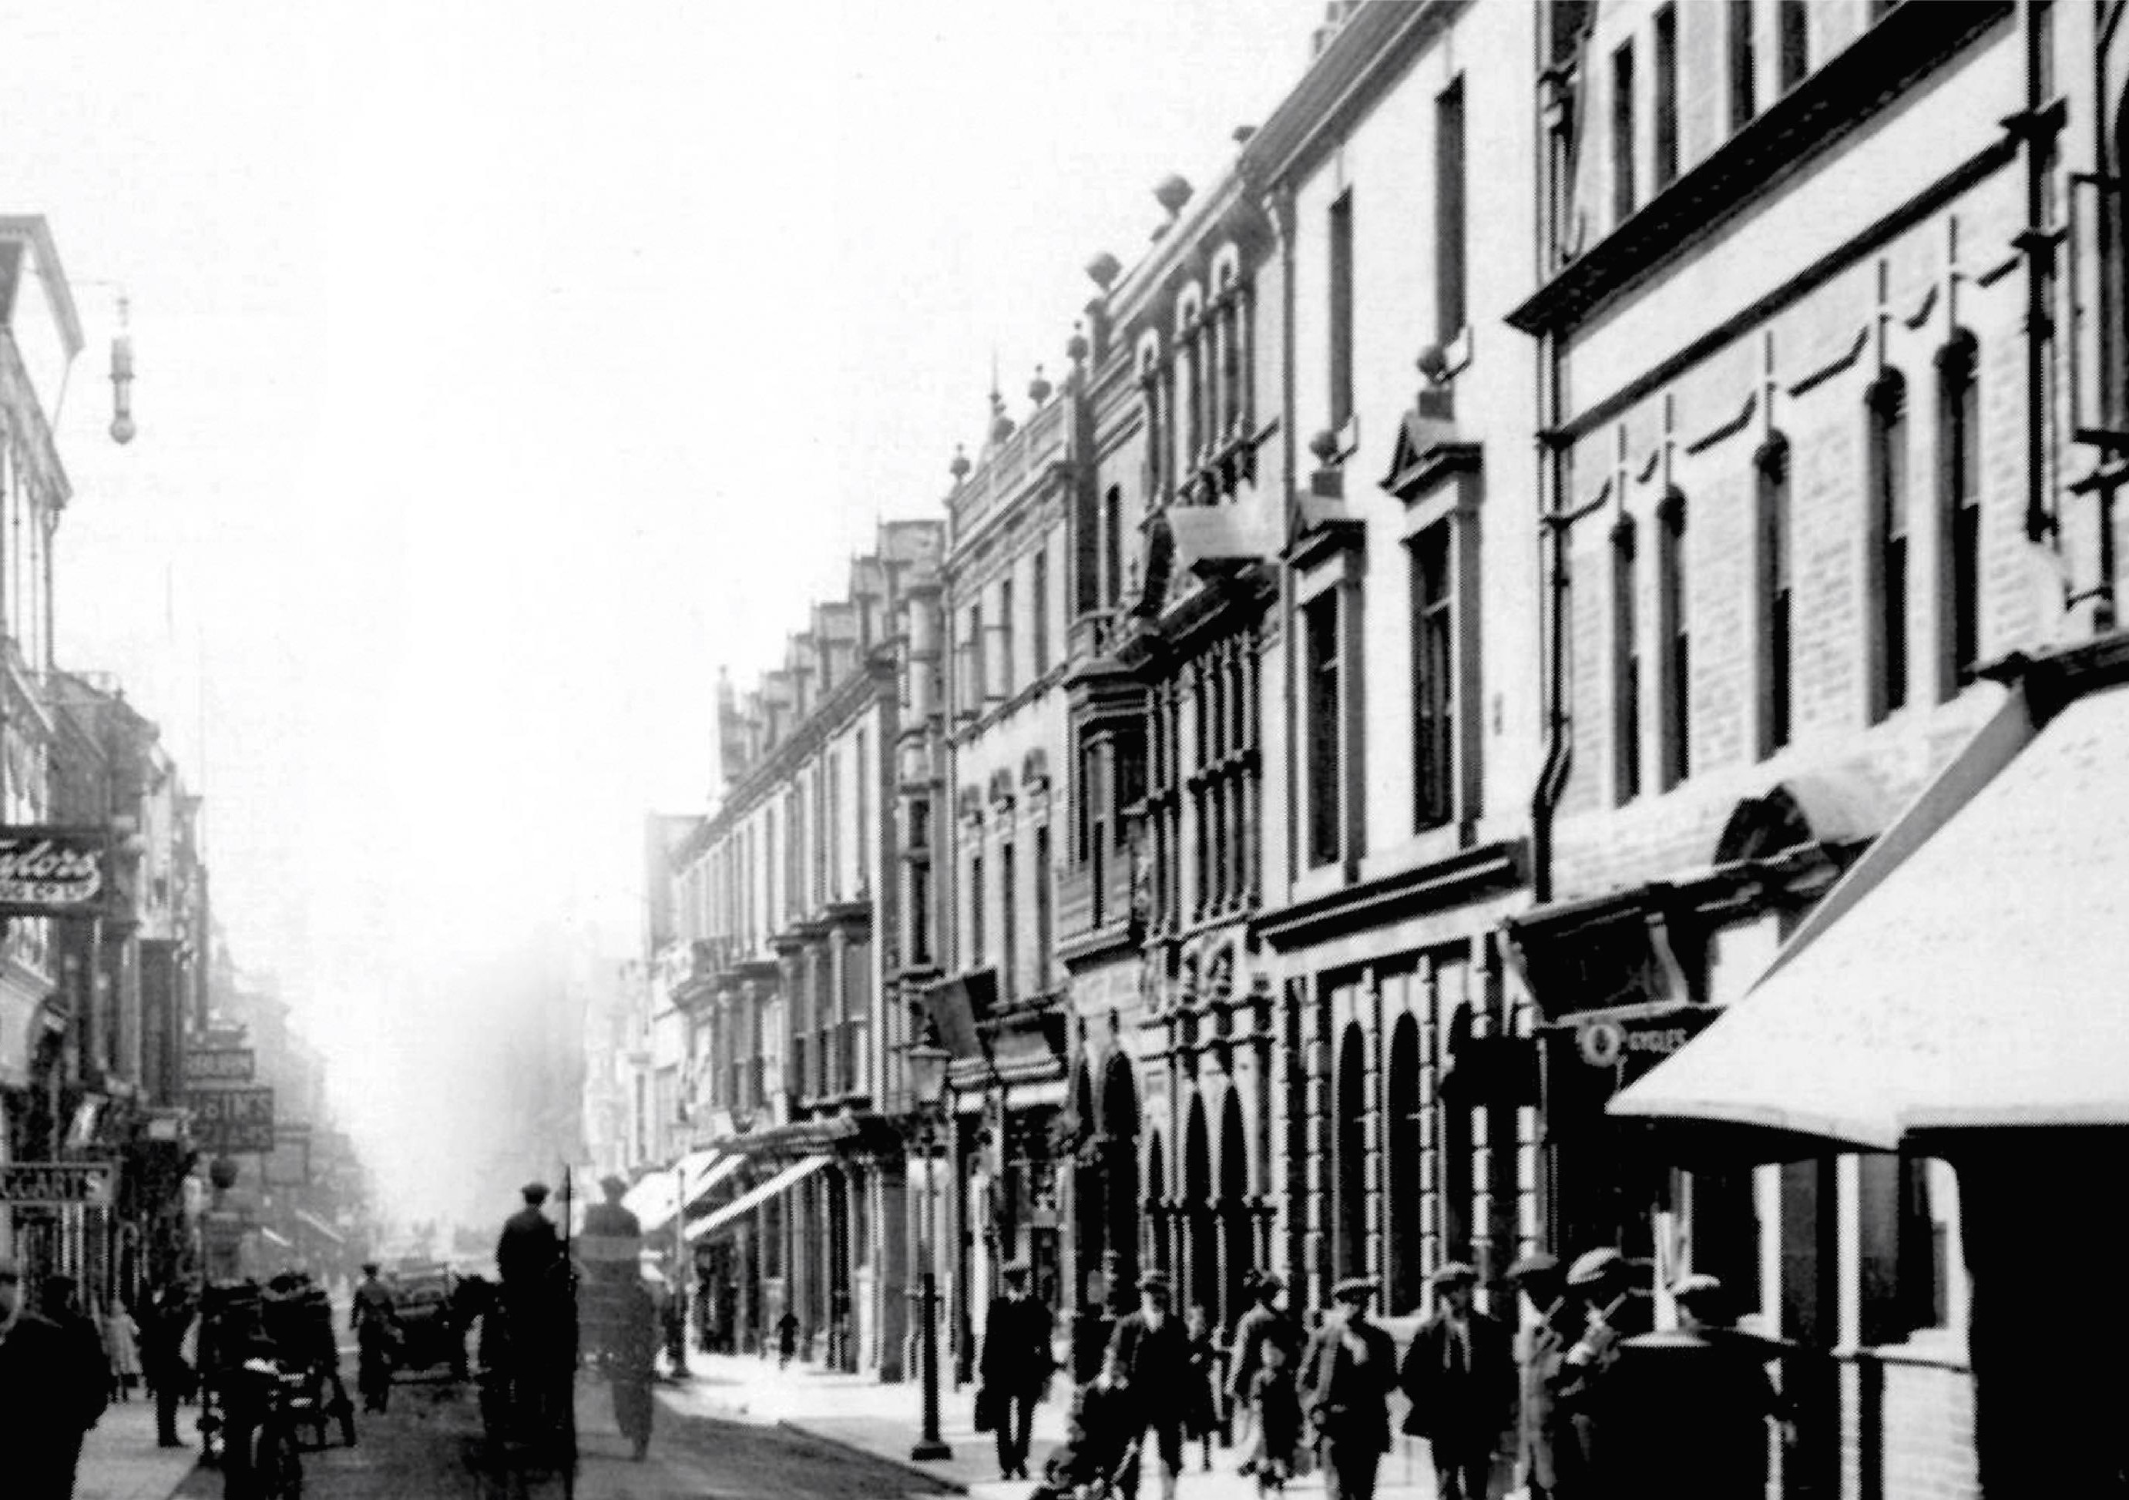
Newgate Street c. 1914. On the righthand side you can see the HAZ restoration target area. Note the awnings.

Slide 12
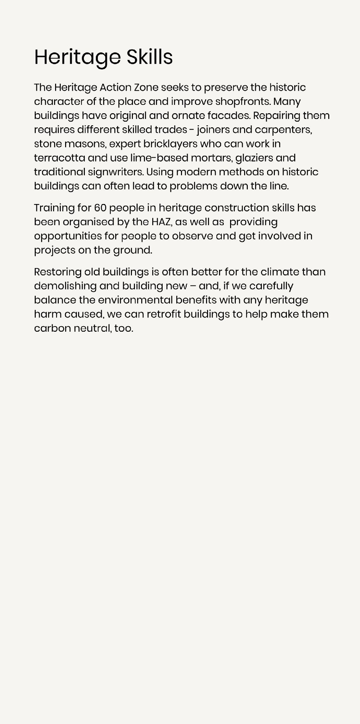
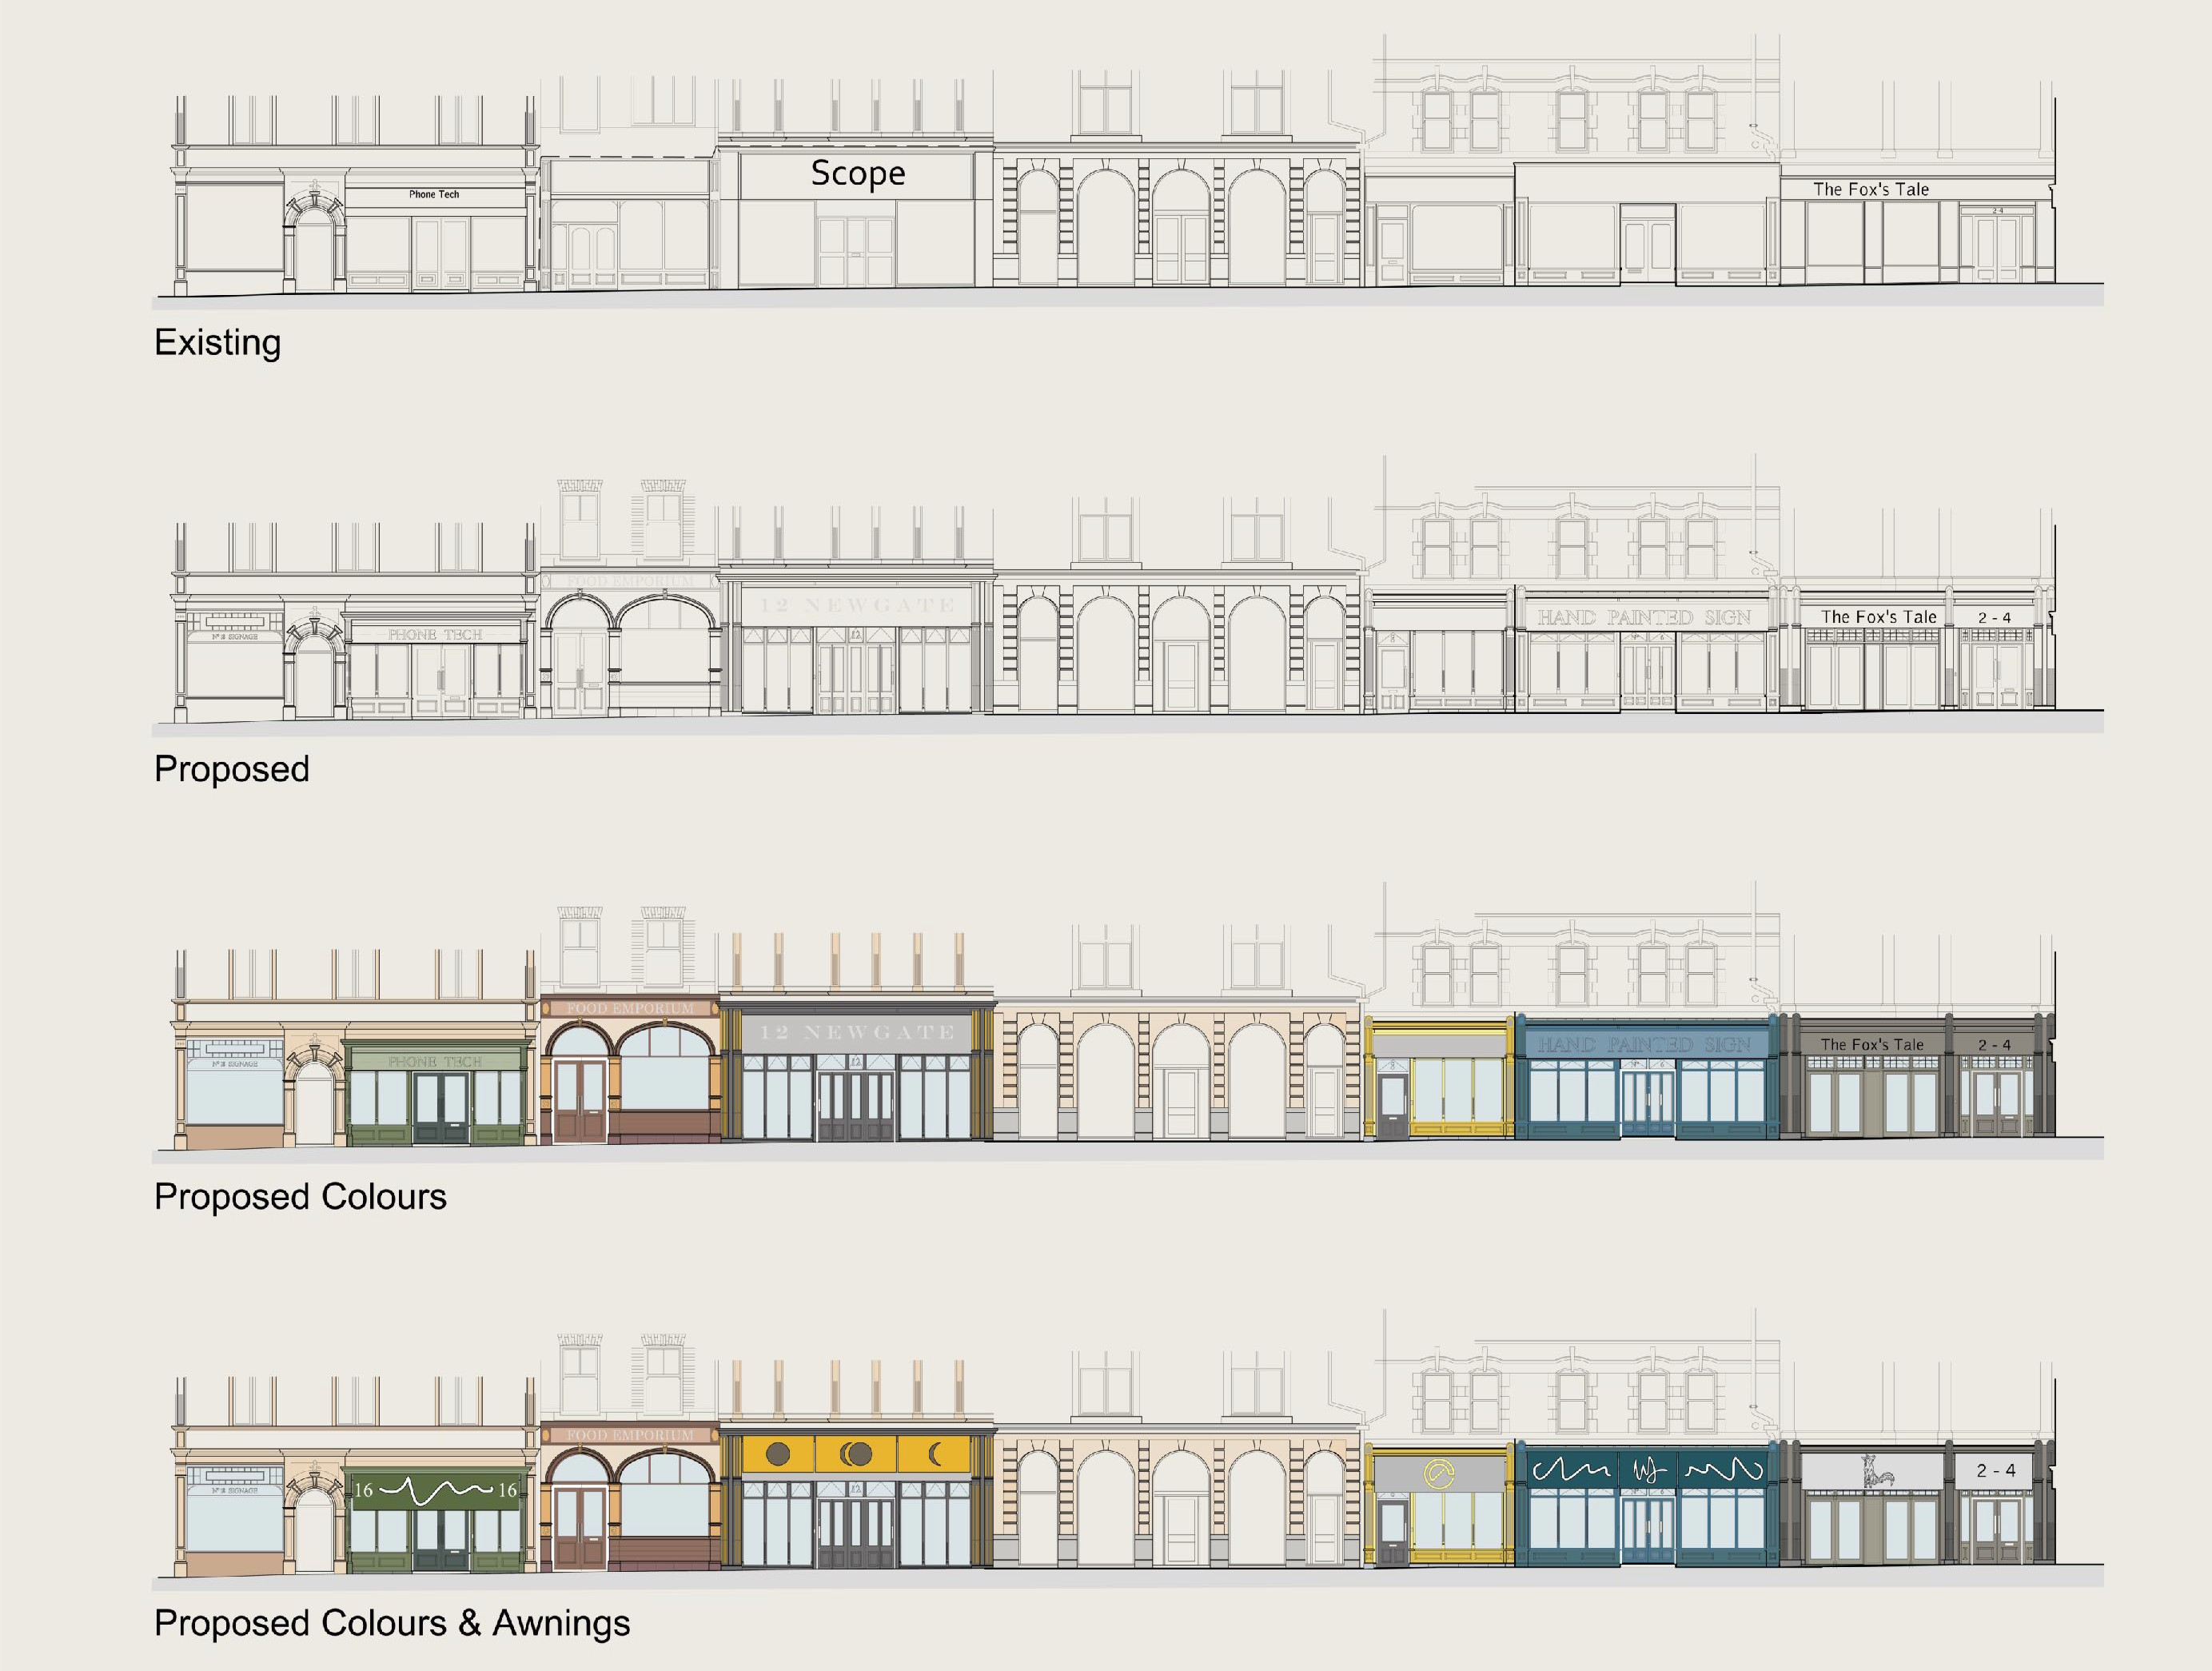
Architectural drawings of 2-22 Newgate Street by Napper Architects, the conservation architect for the HAZ.

Slide 13
Volunteer Cheryl Blakey seals late medieval plaster with distemper to preserve it. West Mural Wall Tower, 2019.

Slide 14
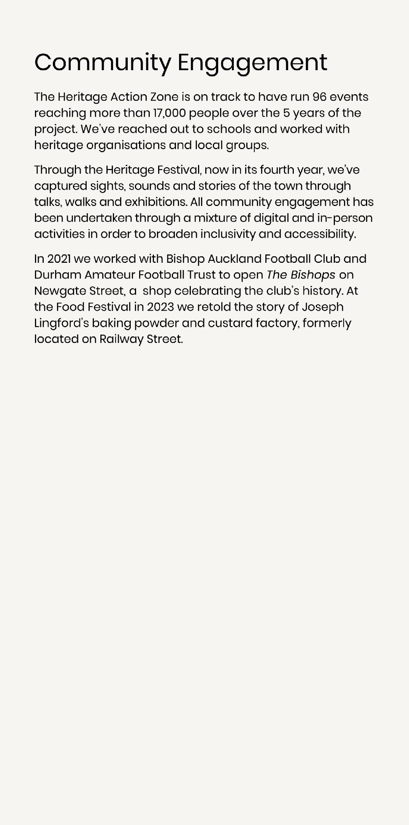
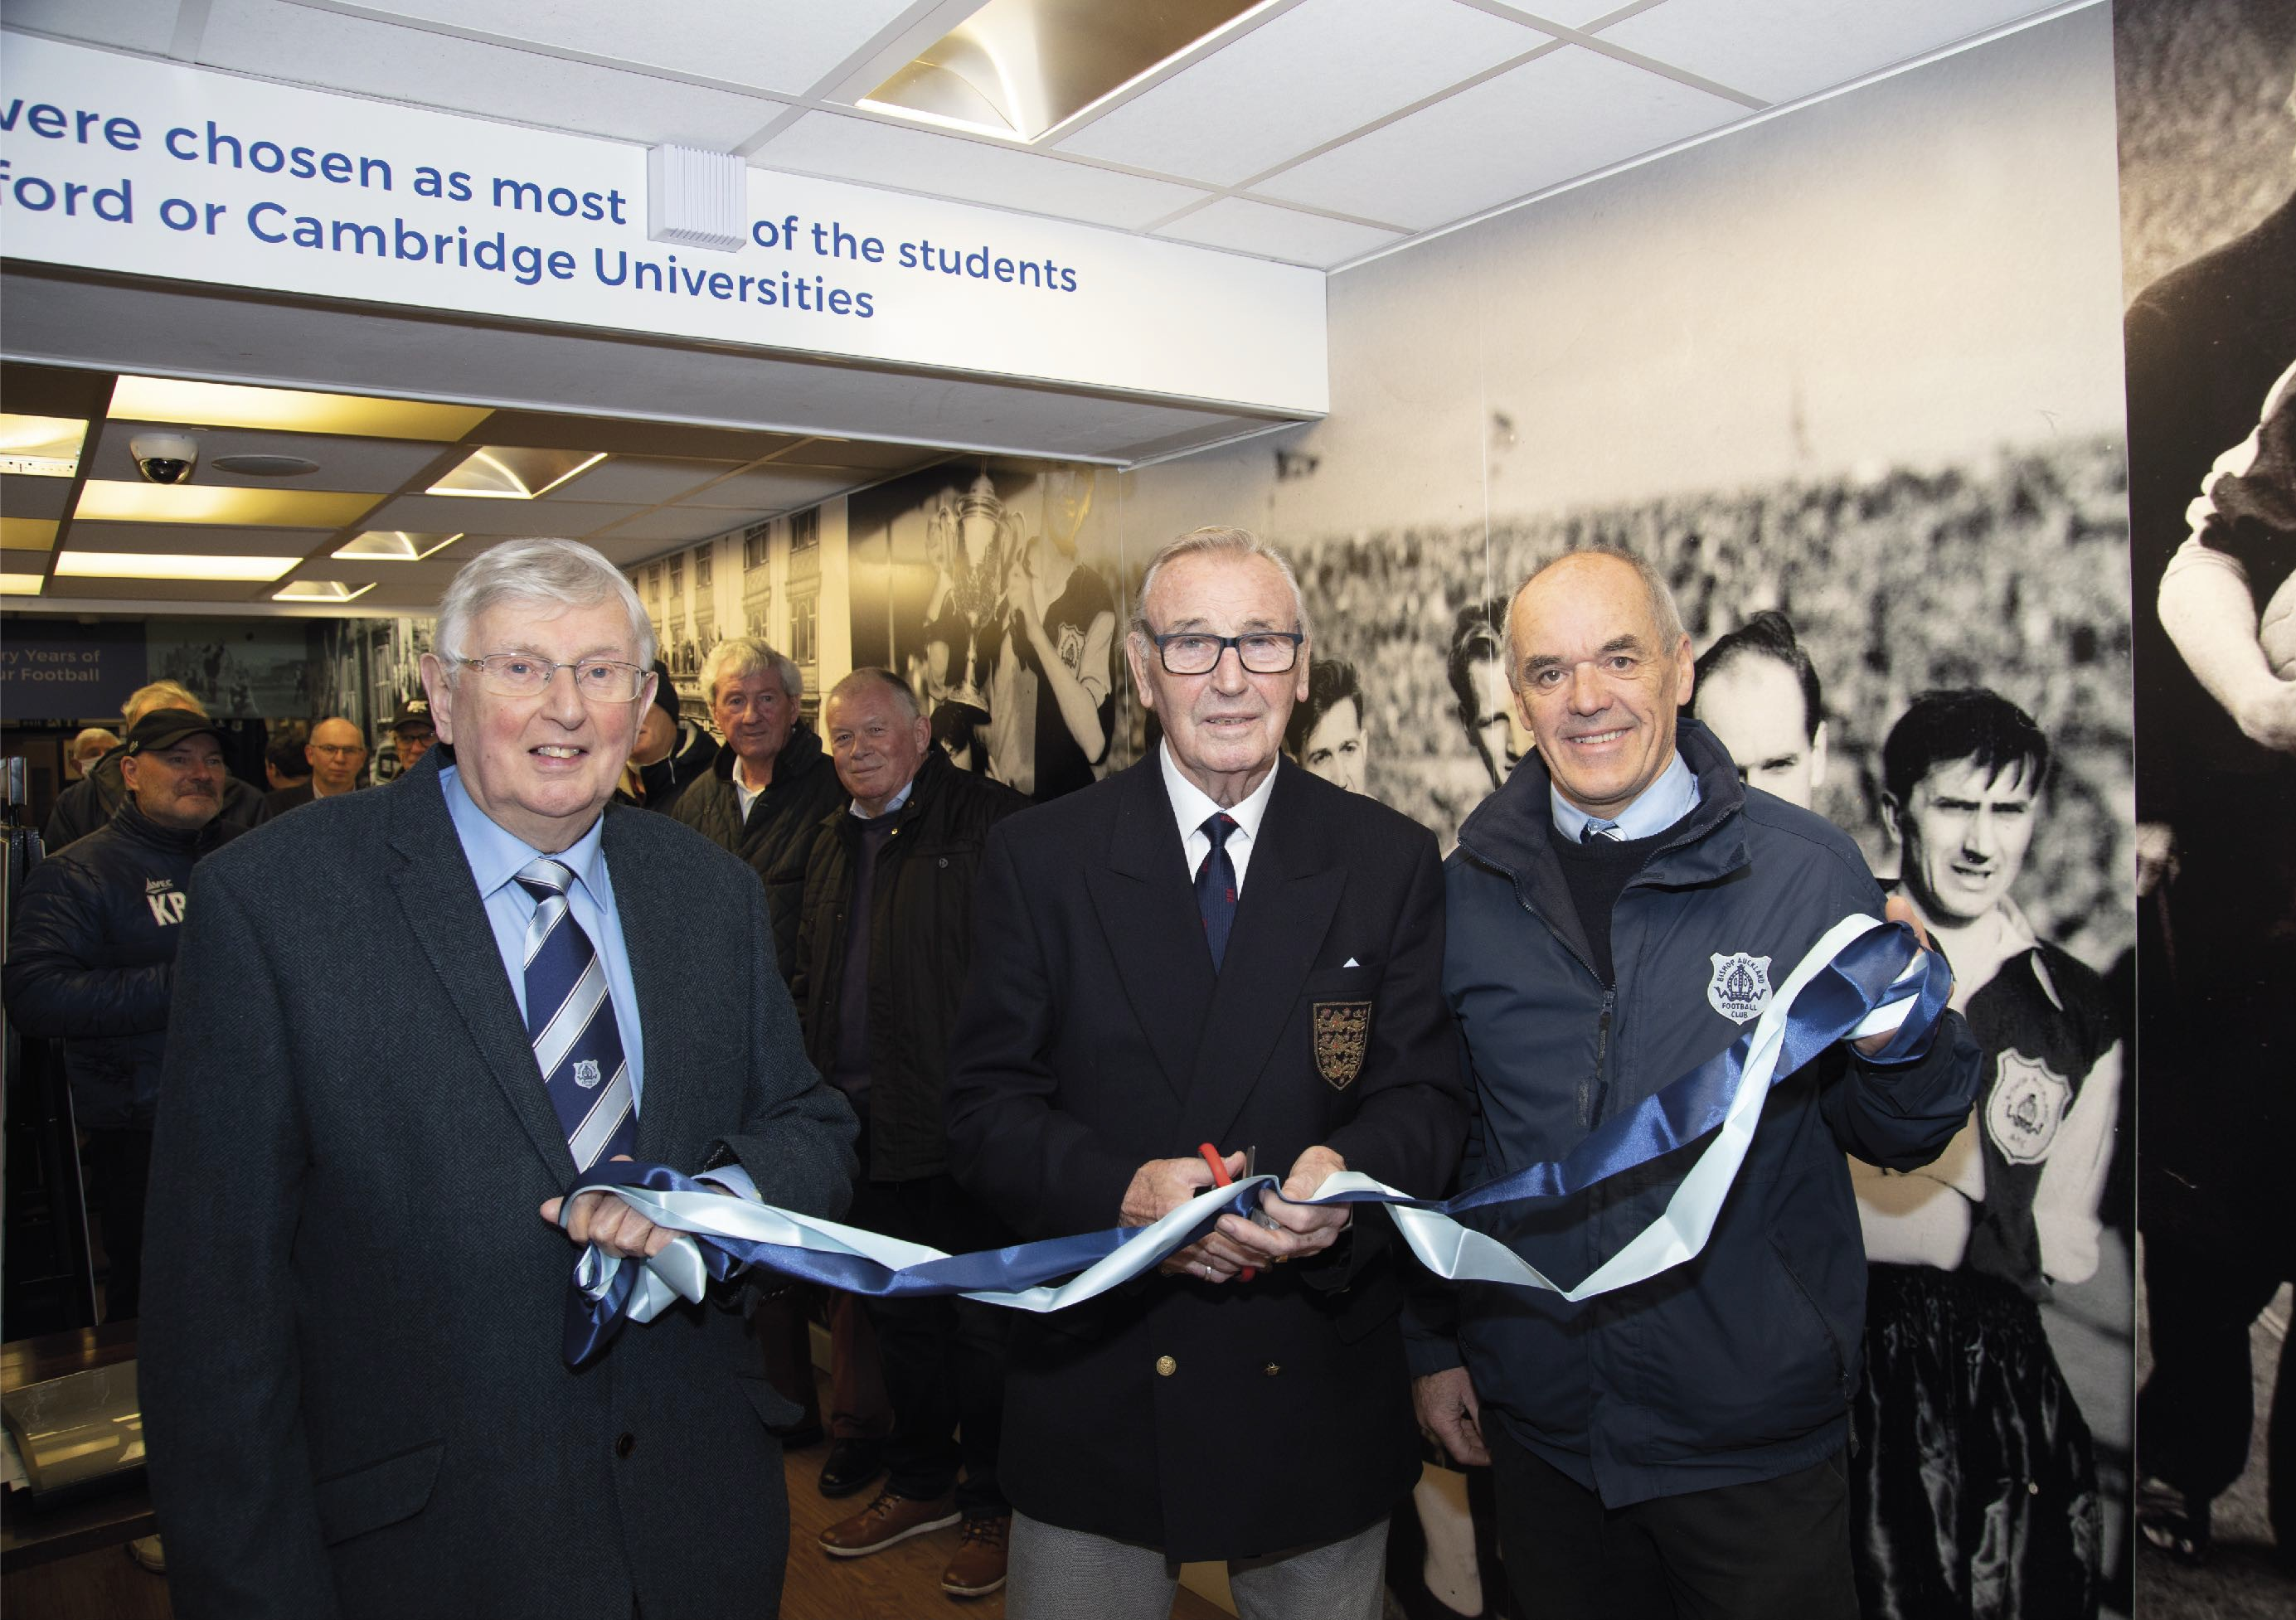
Visit The Bishops football heritage shop created by Bishop Auckland Football Club and Durham Amateur Football Trust.

Slide 15
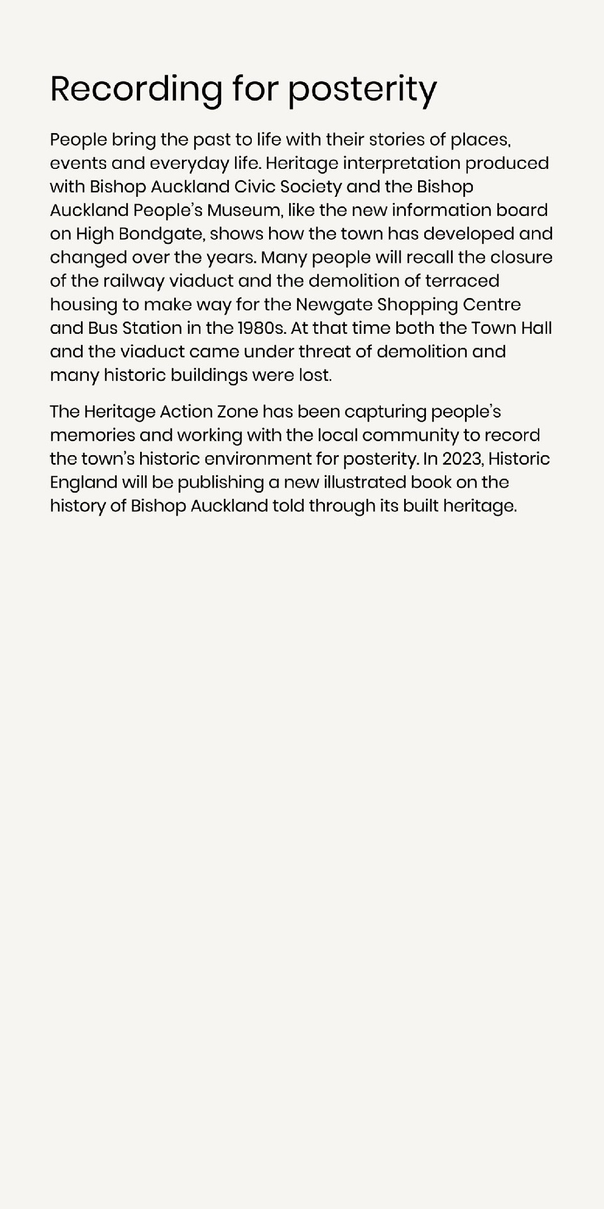
New heritage interpretation has been installed on High Bondgate and Durham Chare with help from Bishop Auckland Civic Society.

Slide 16
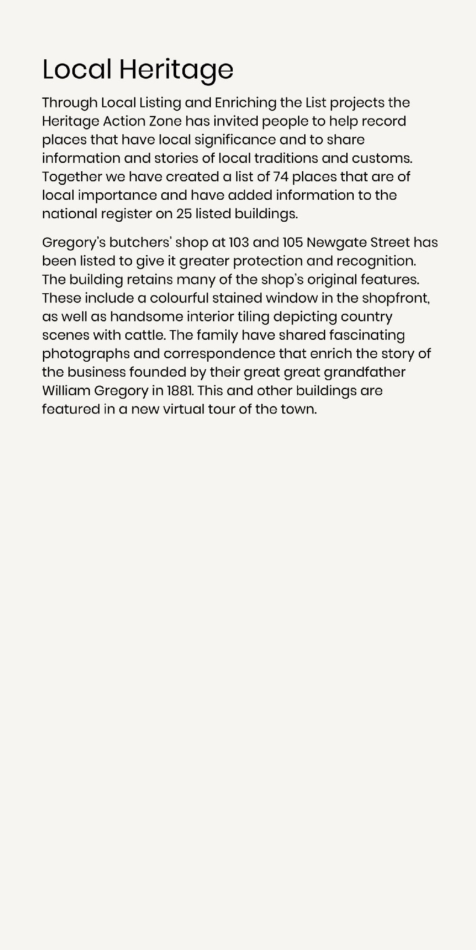
A new railway heritage trail has been established by the People’s Museum. This is one of two new panels on Newton Cap Bank.

Slide 17
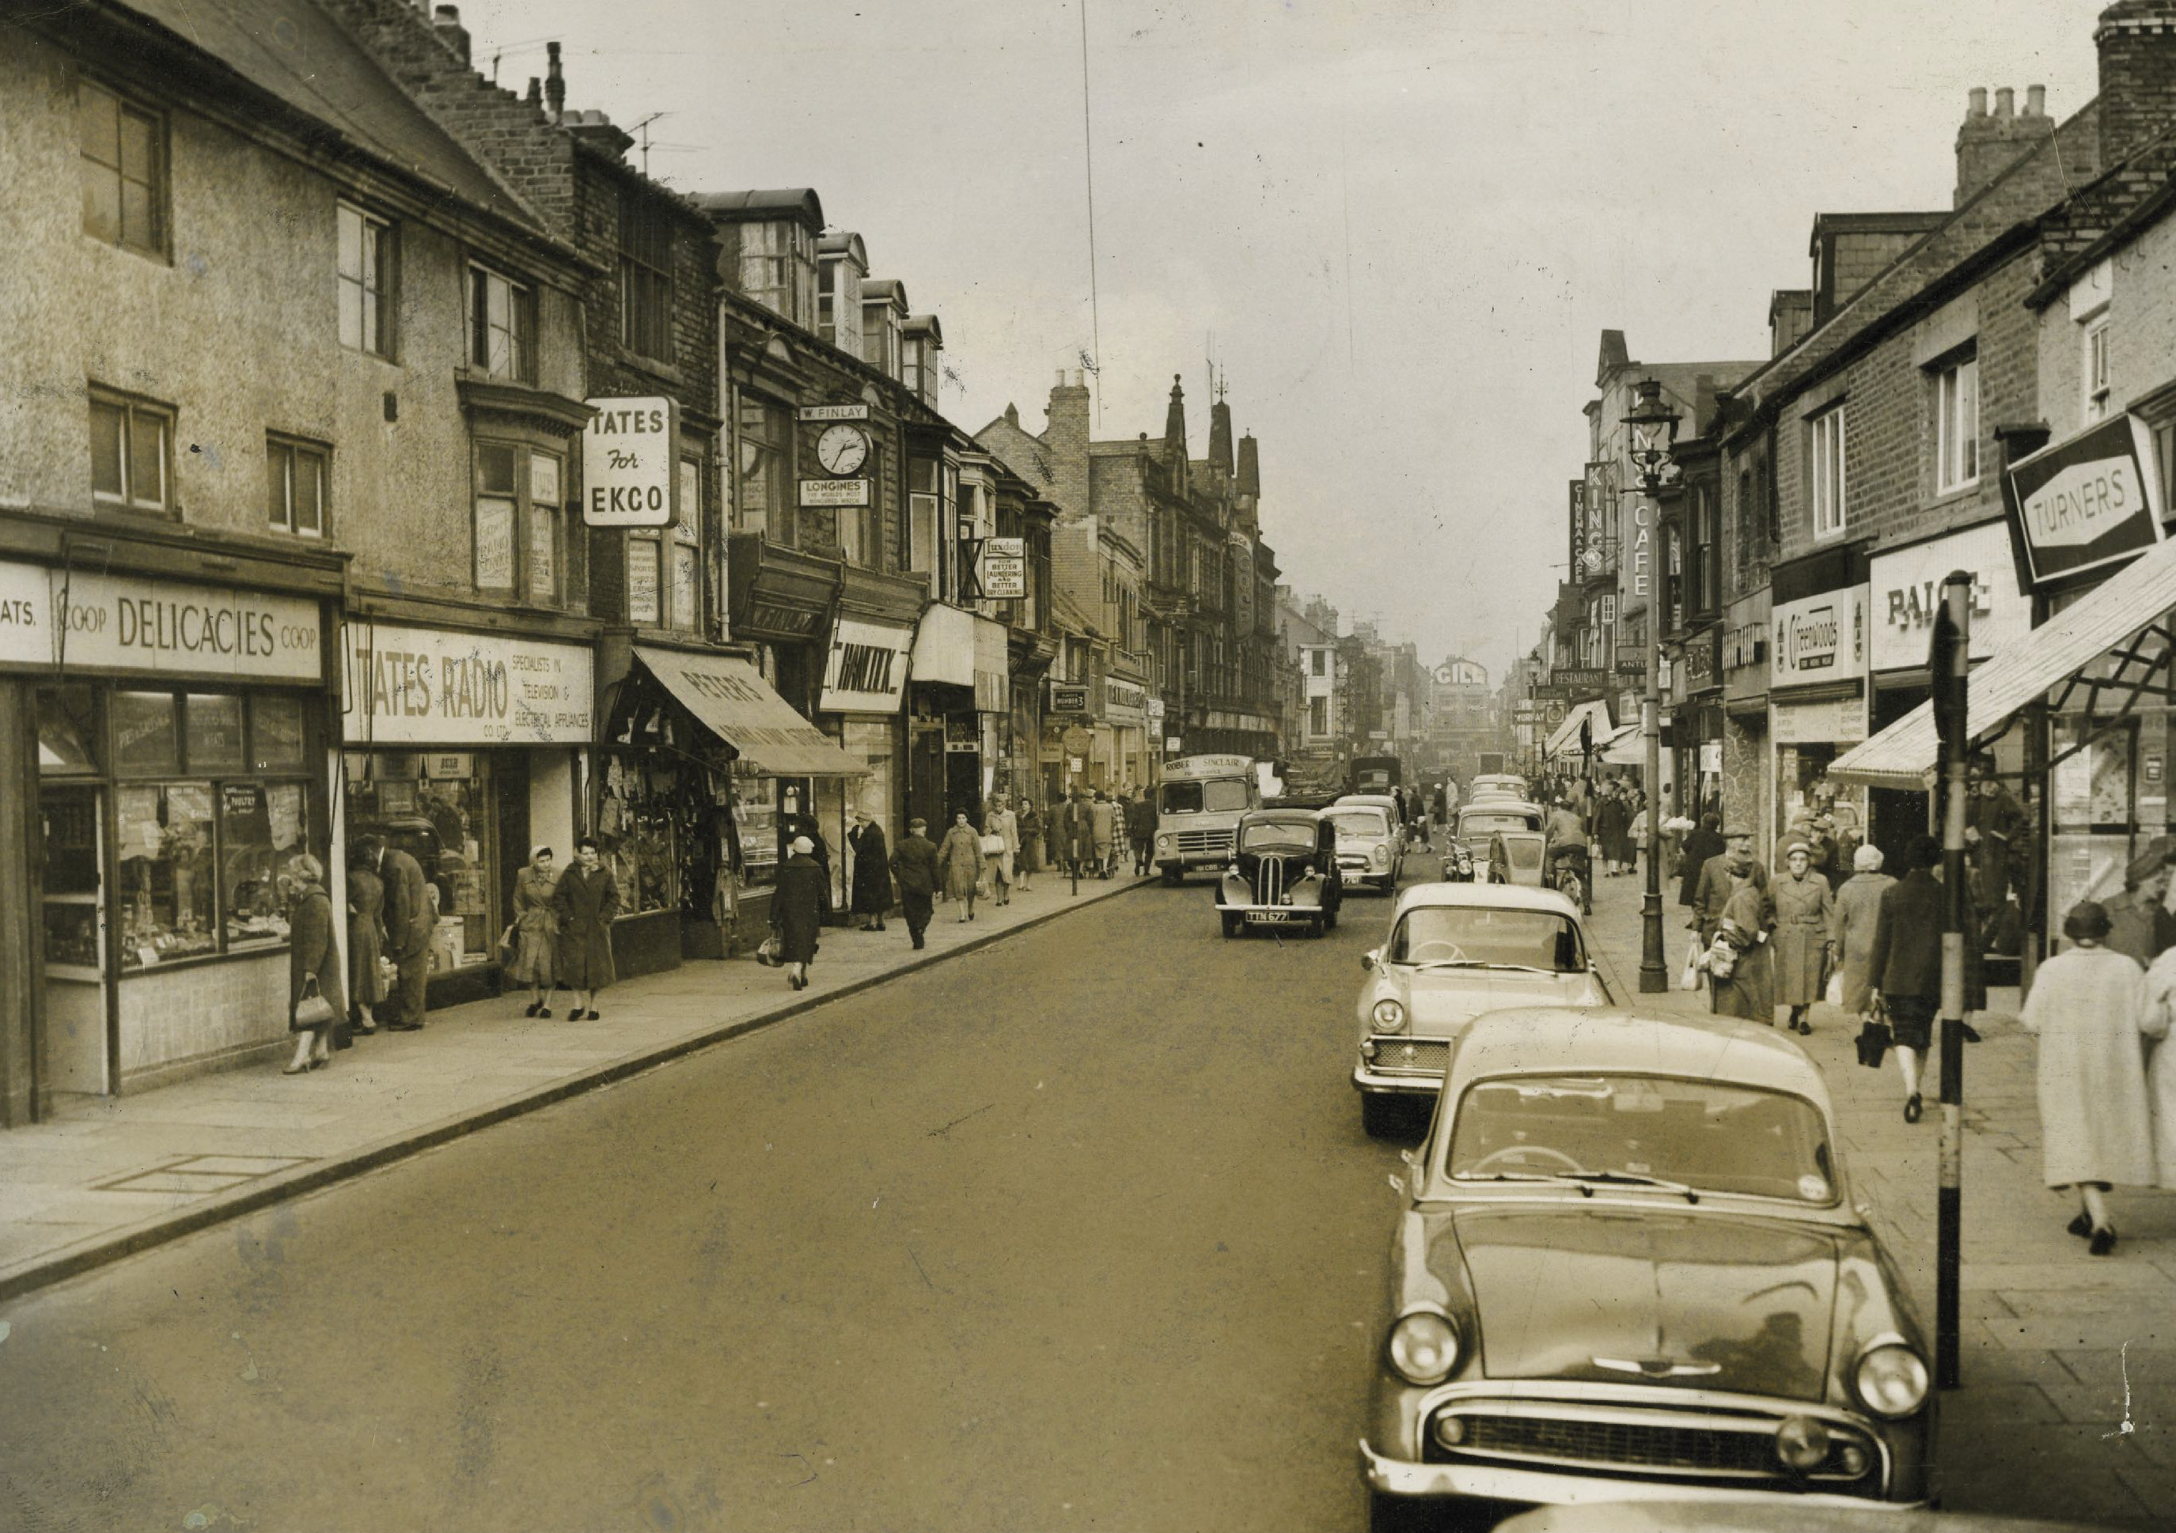
Newgate Street in the 1960s looking towards the Market Place. Gregory’s shop (with the awning) is just visible on the righthand side.

Slide 18
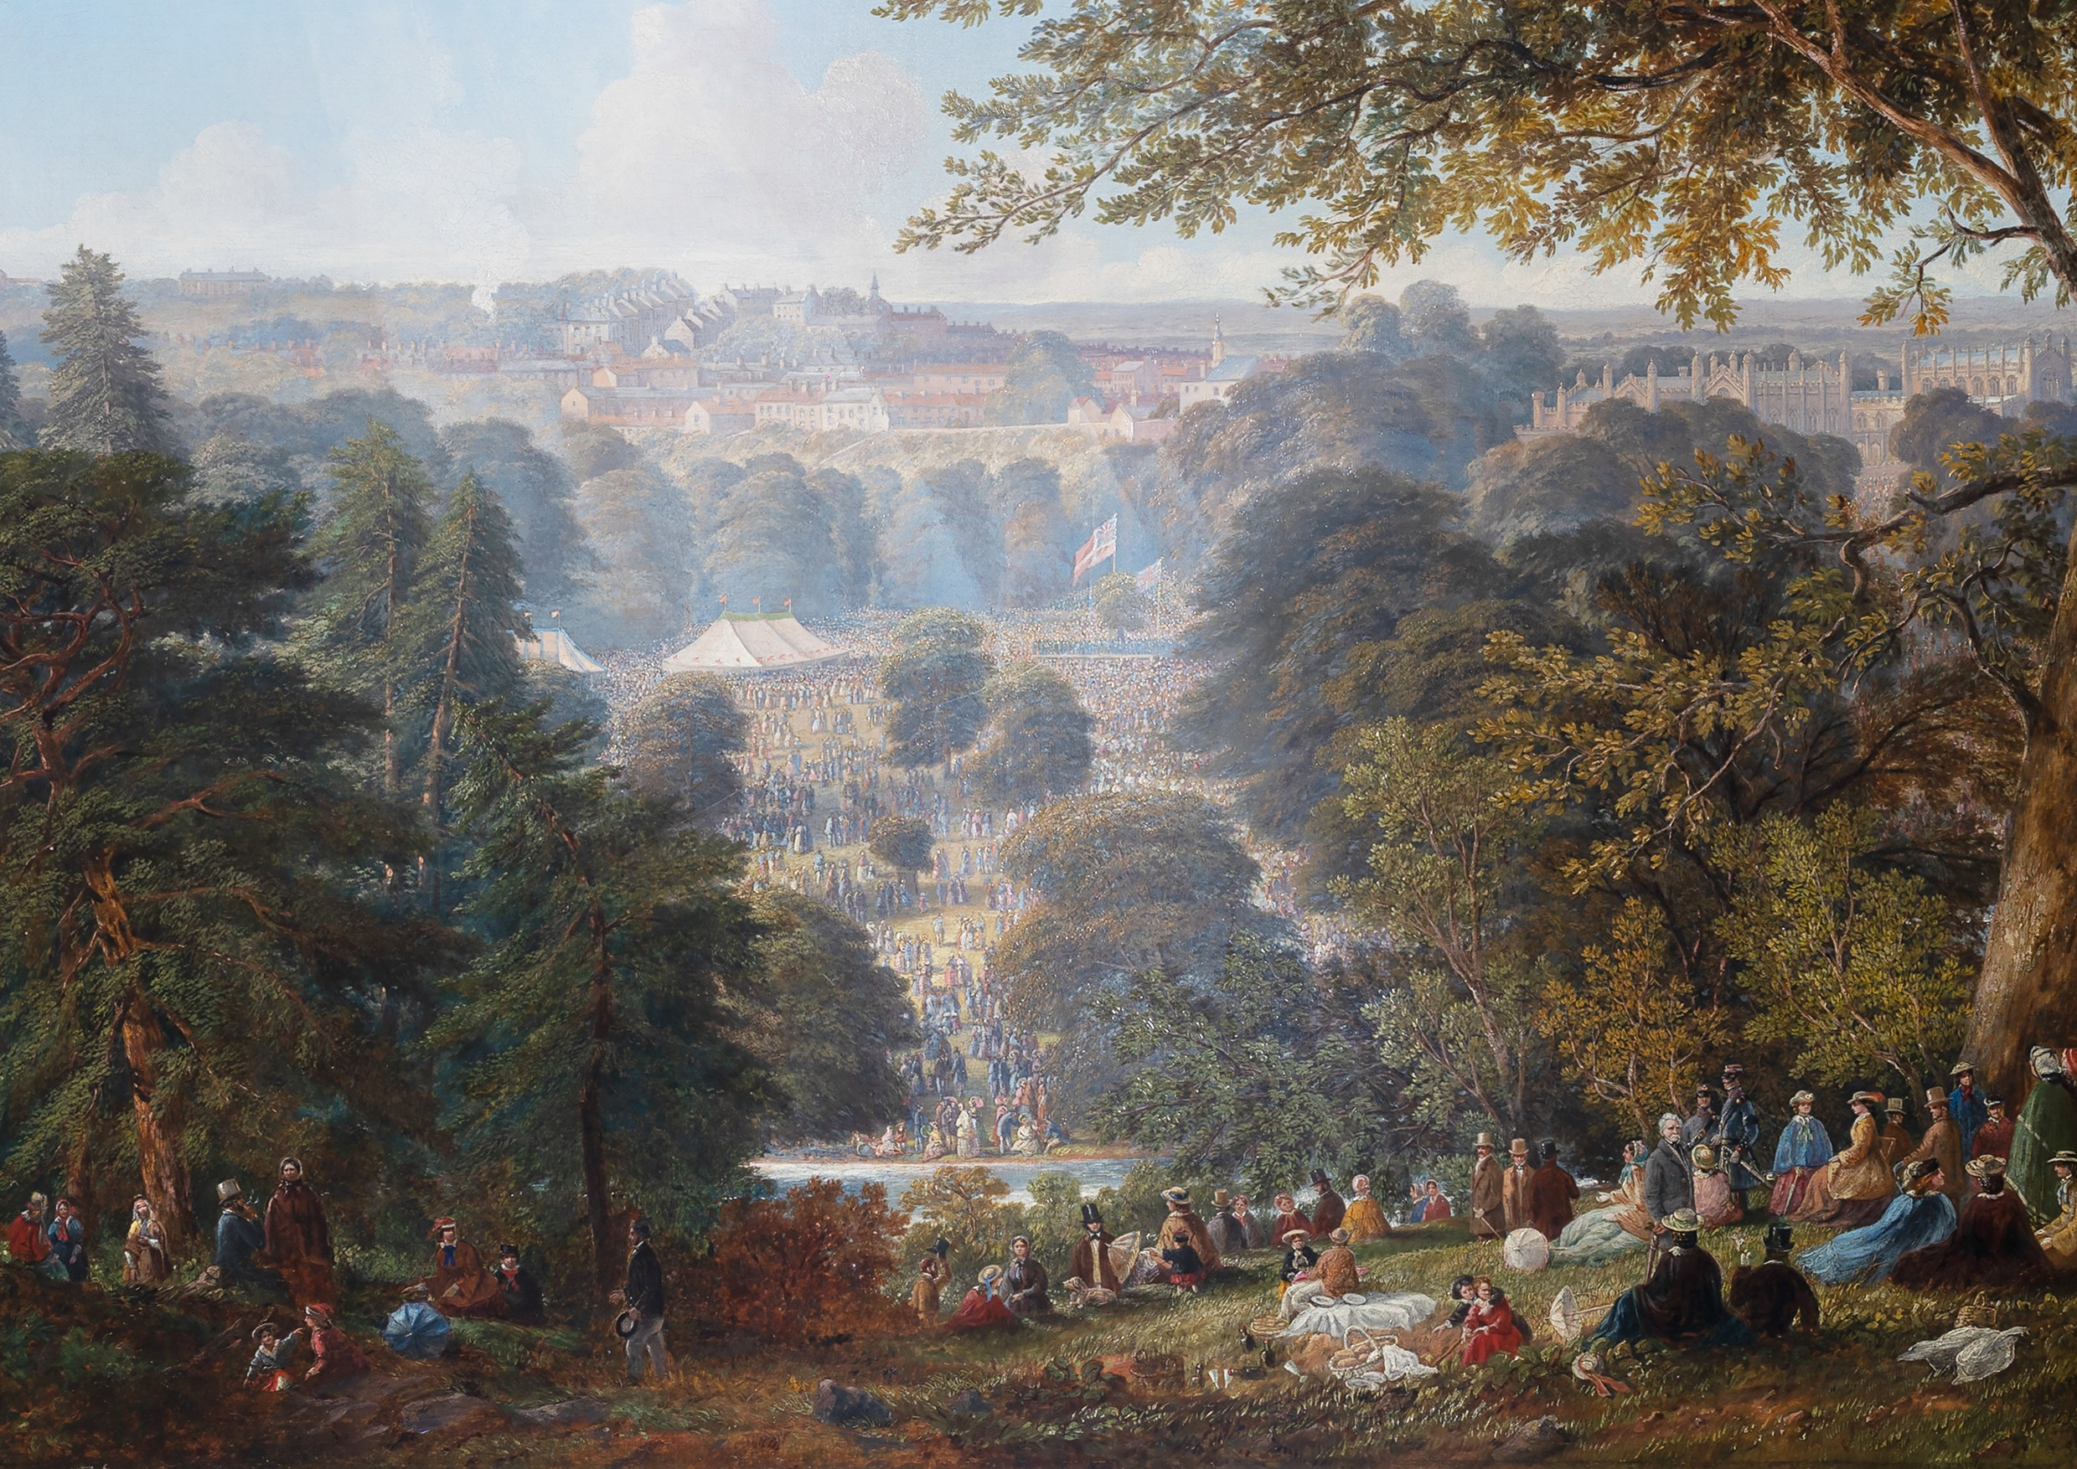
Flower Show in Auckland Park, County Durham, 1859. Painting by John Wilson Carmichael (1799 -1868). This event was held annually from 1852 to 1881 and attracted crowds of over 20,000 people.

Slide 19
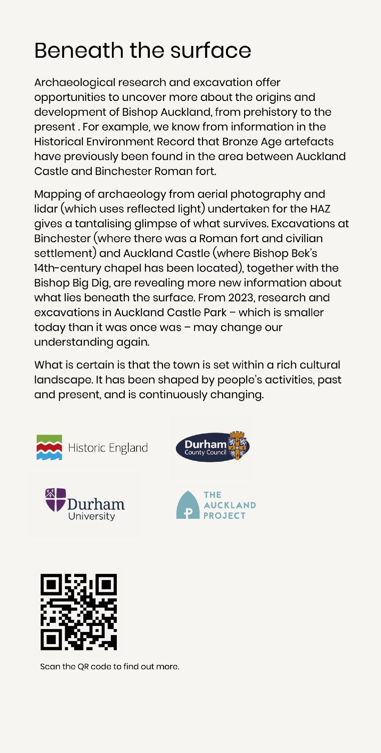
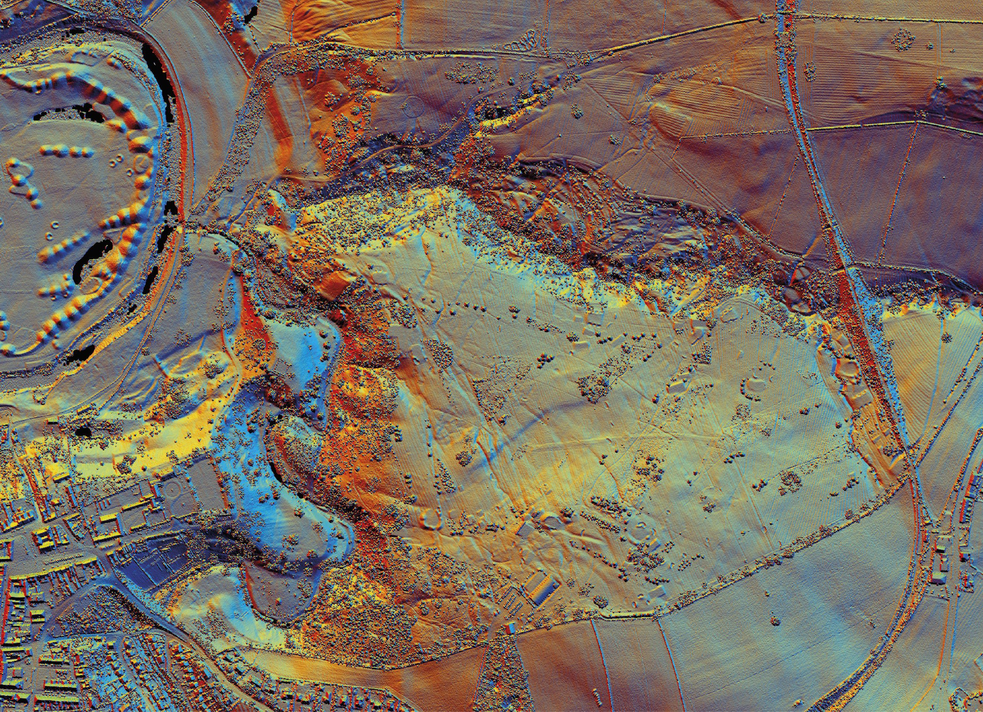
Lidar (reflected light) 1m digital surface model for Auckland Castle Park. © Historic England. Source: Environment Agency, June 2007.

Slide 20
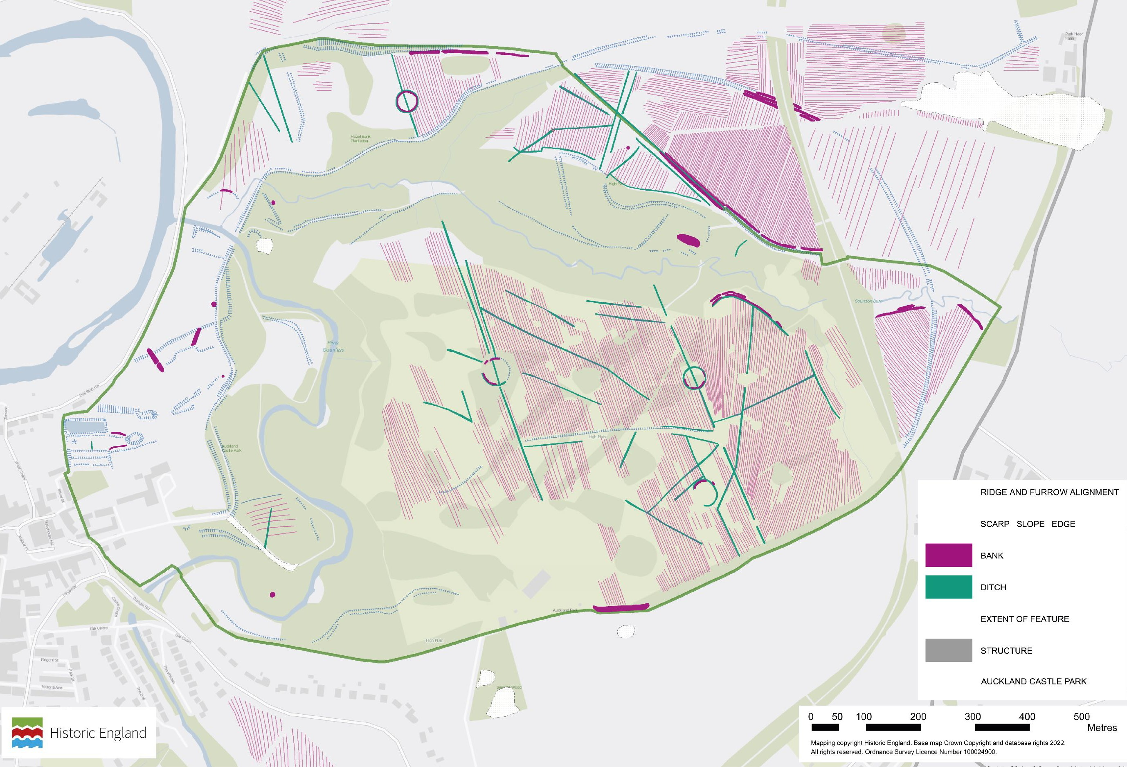
The results of the aerial investigation and mapping by Historic England which examined historic air photographs and modern lidar to record archaeological features across Auckland Castle Park. Mapping © Historic England.
Base map Crown Copyright and database rights 2022. All rights reserved. Ordnance Survey Licence Number 100024900.

Slide 21
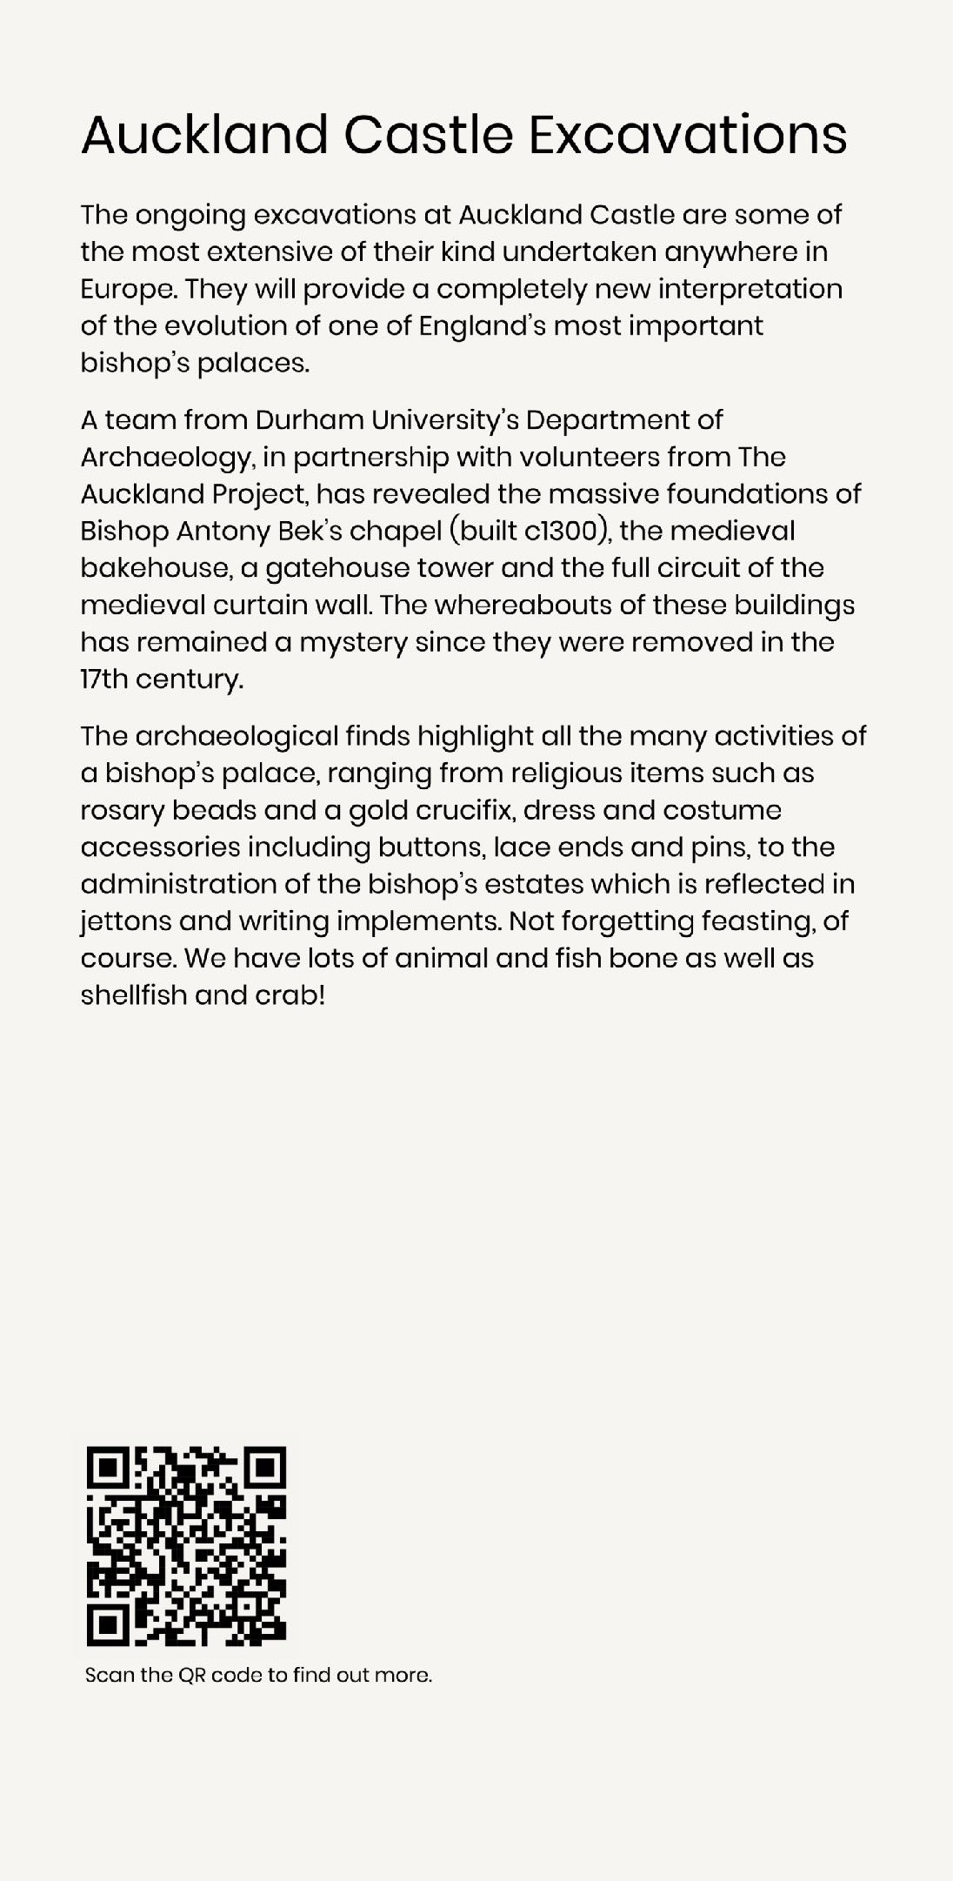
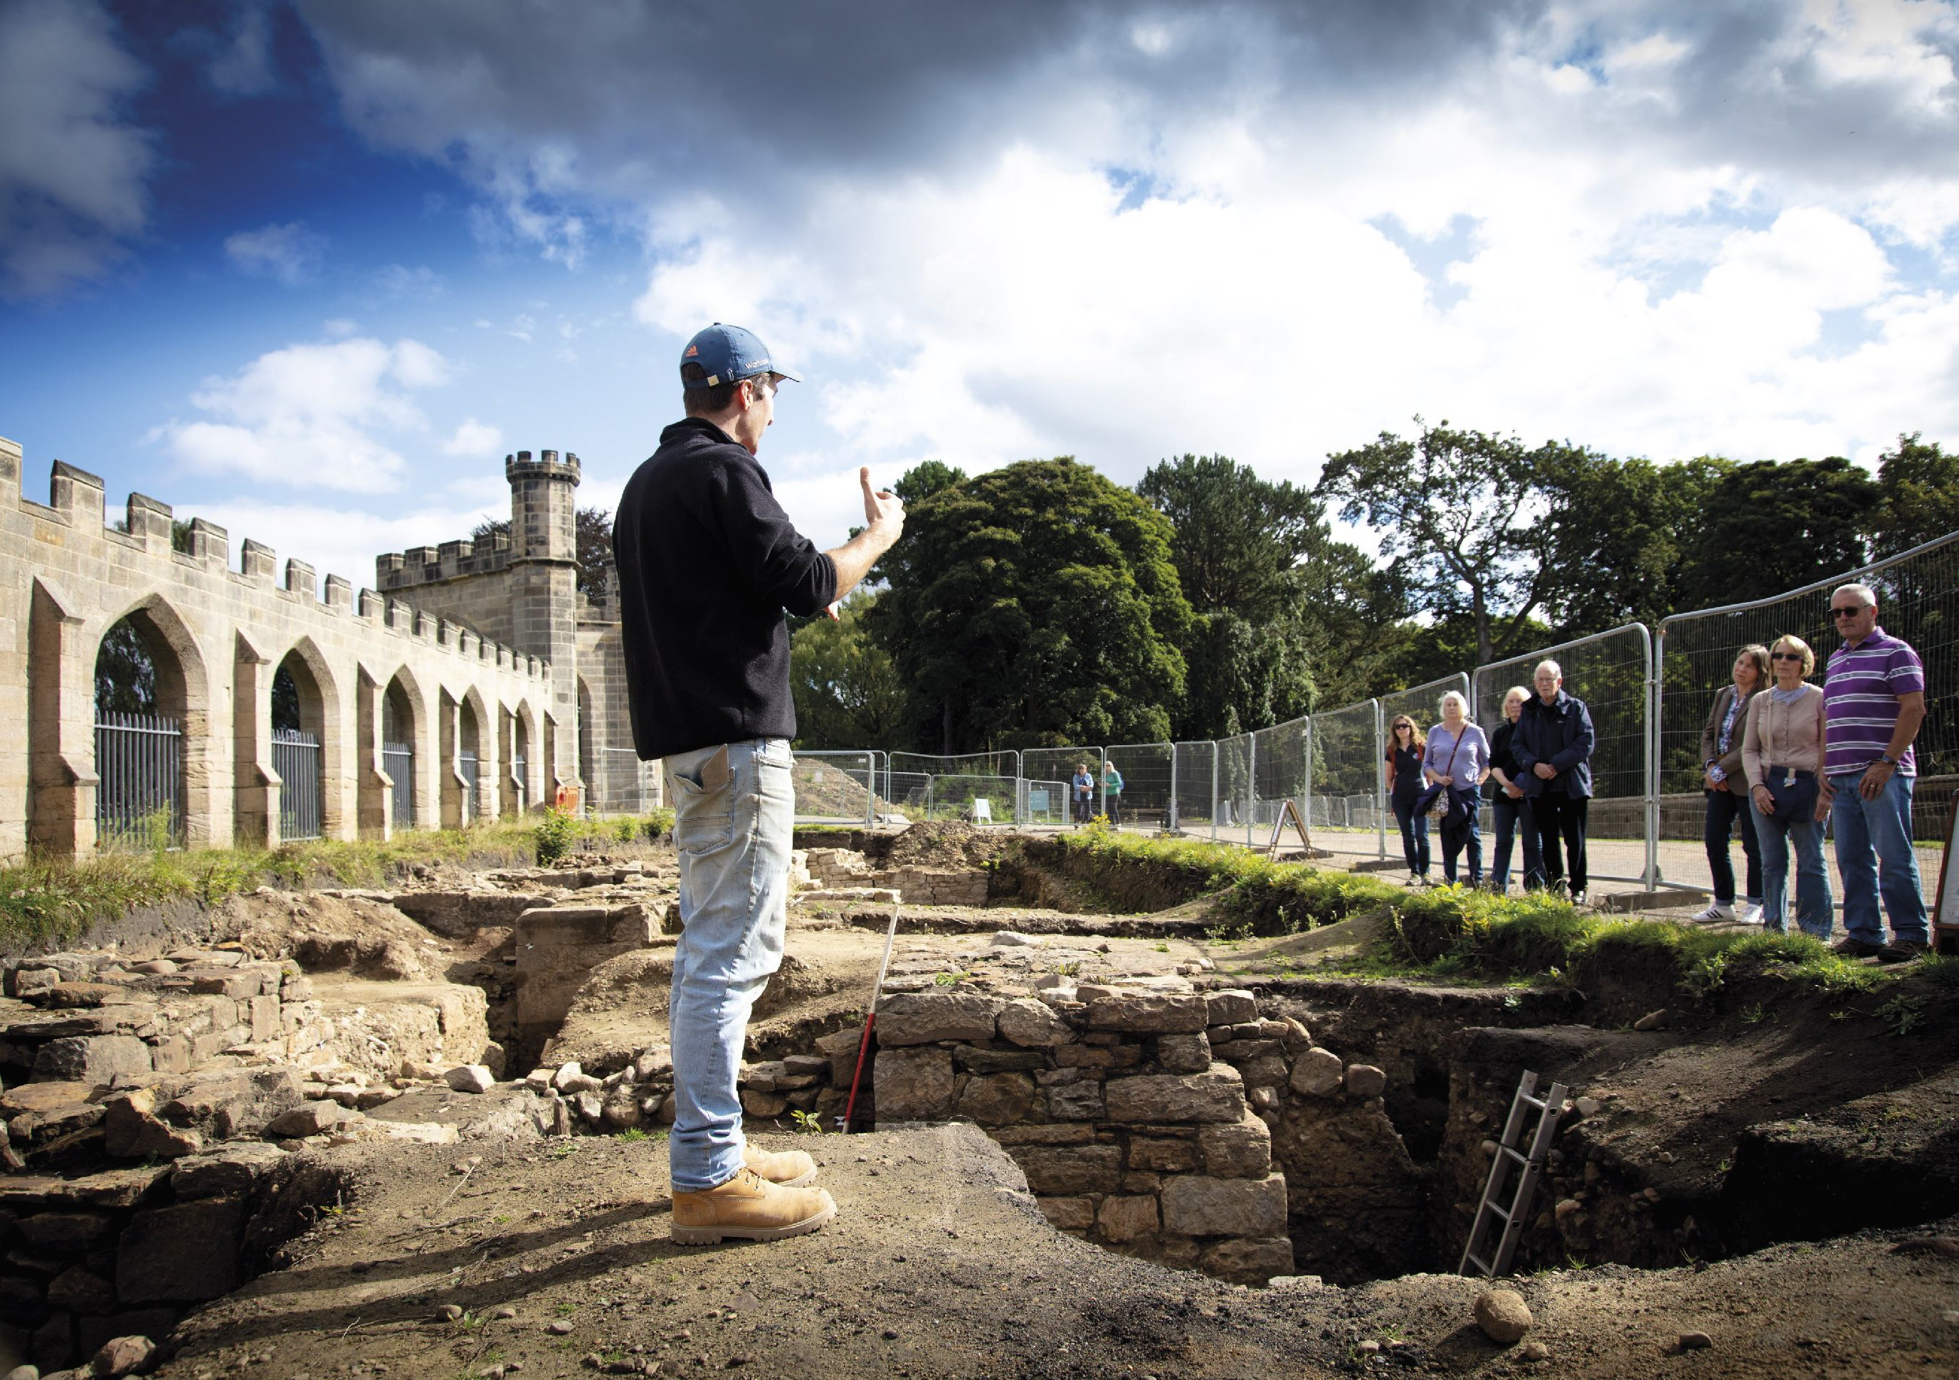
Archaeologist John Castling shows visitors around excavations at Auckland Castle in 2021. © Andrew Heptinstall Photography.

Slide 22
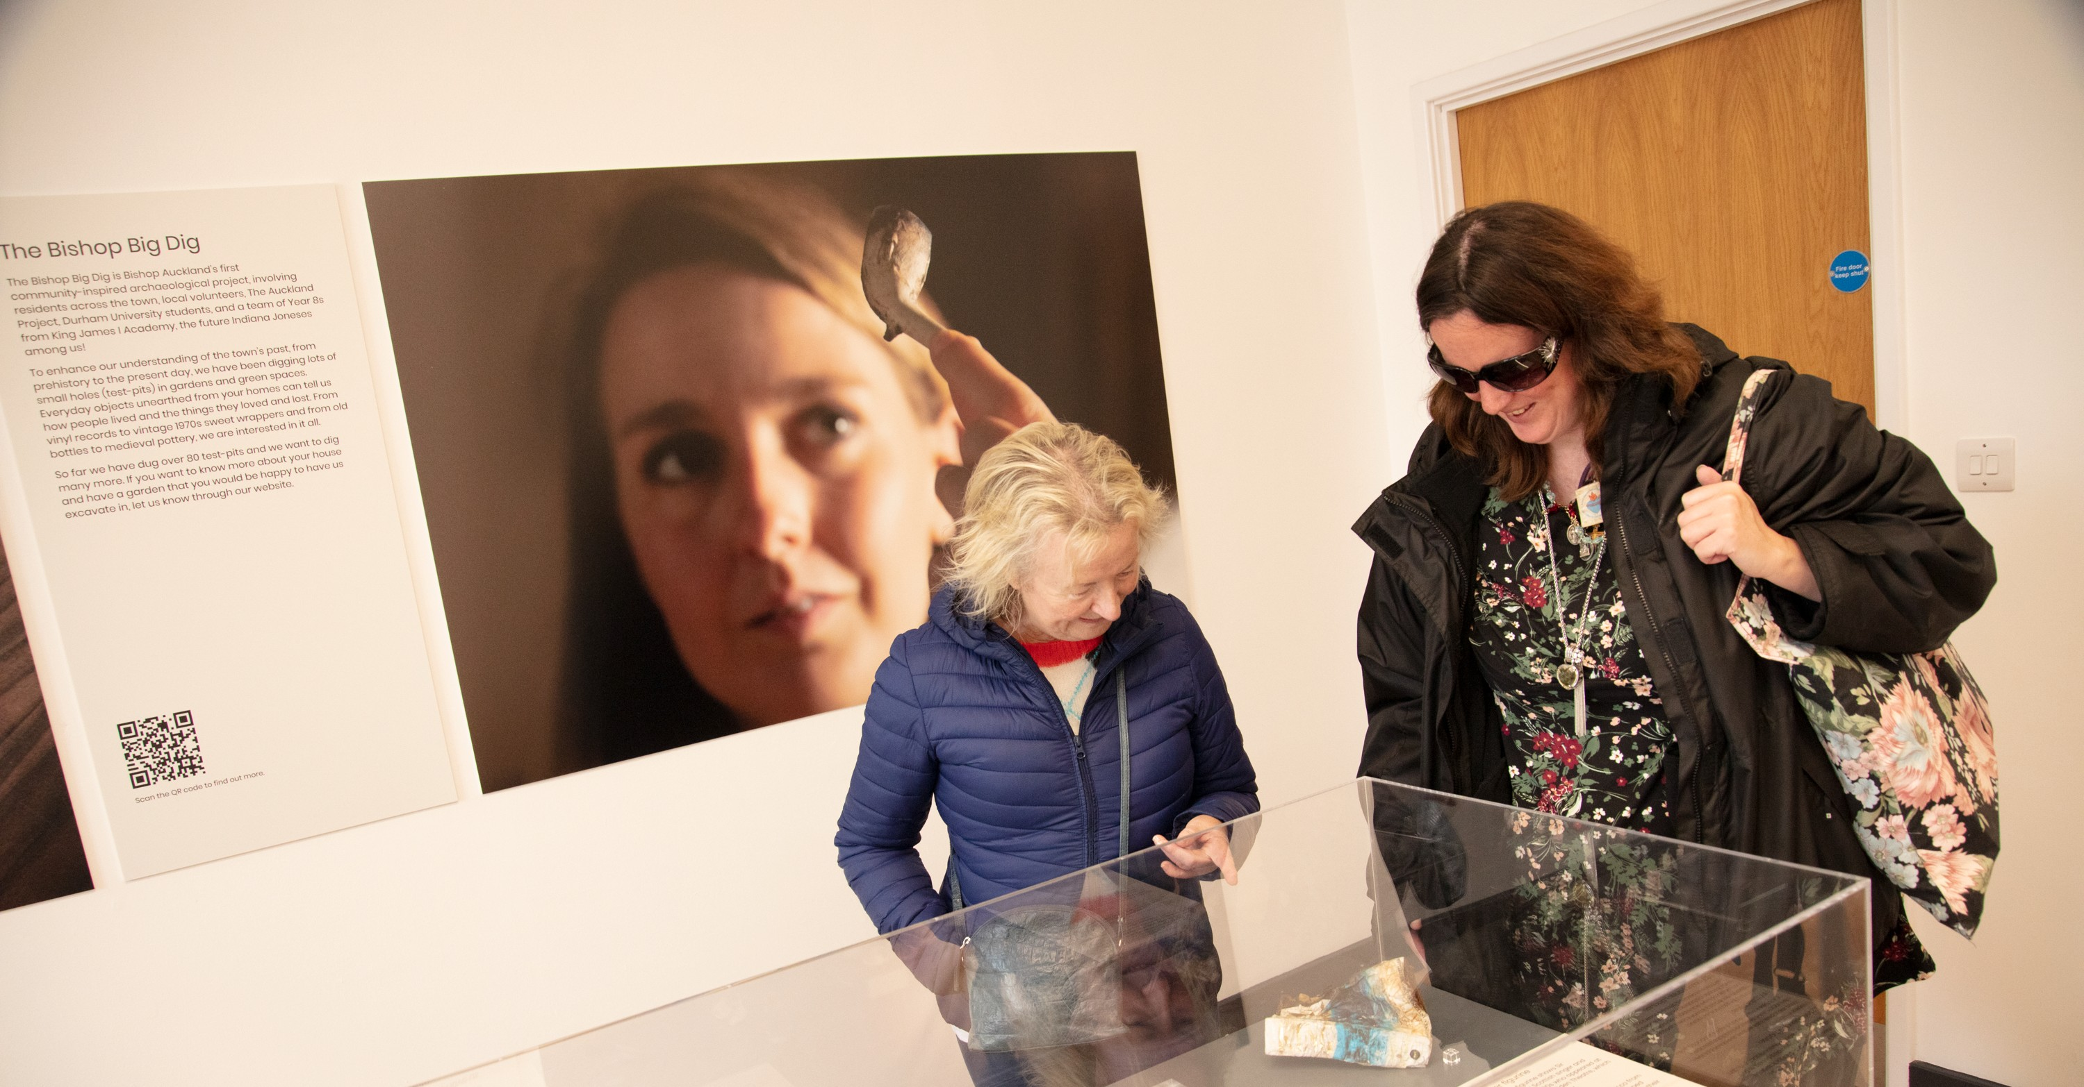

Slide 23
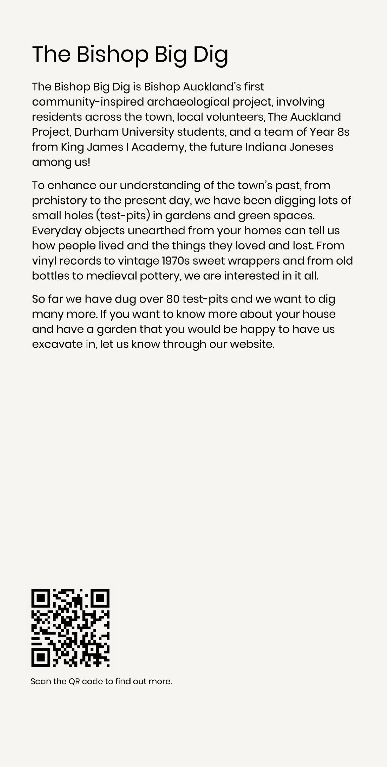
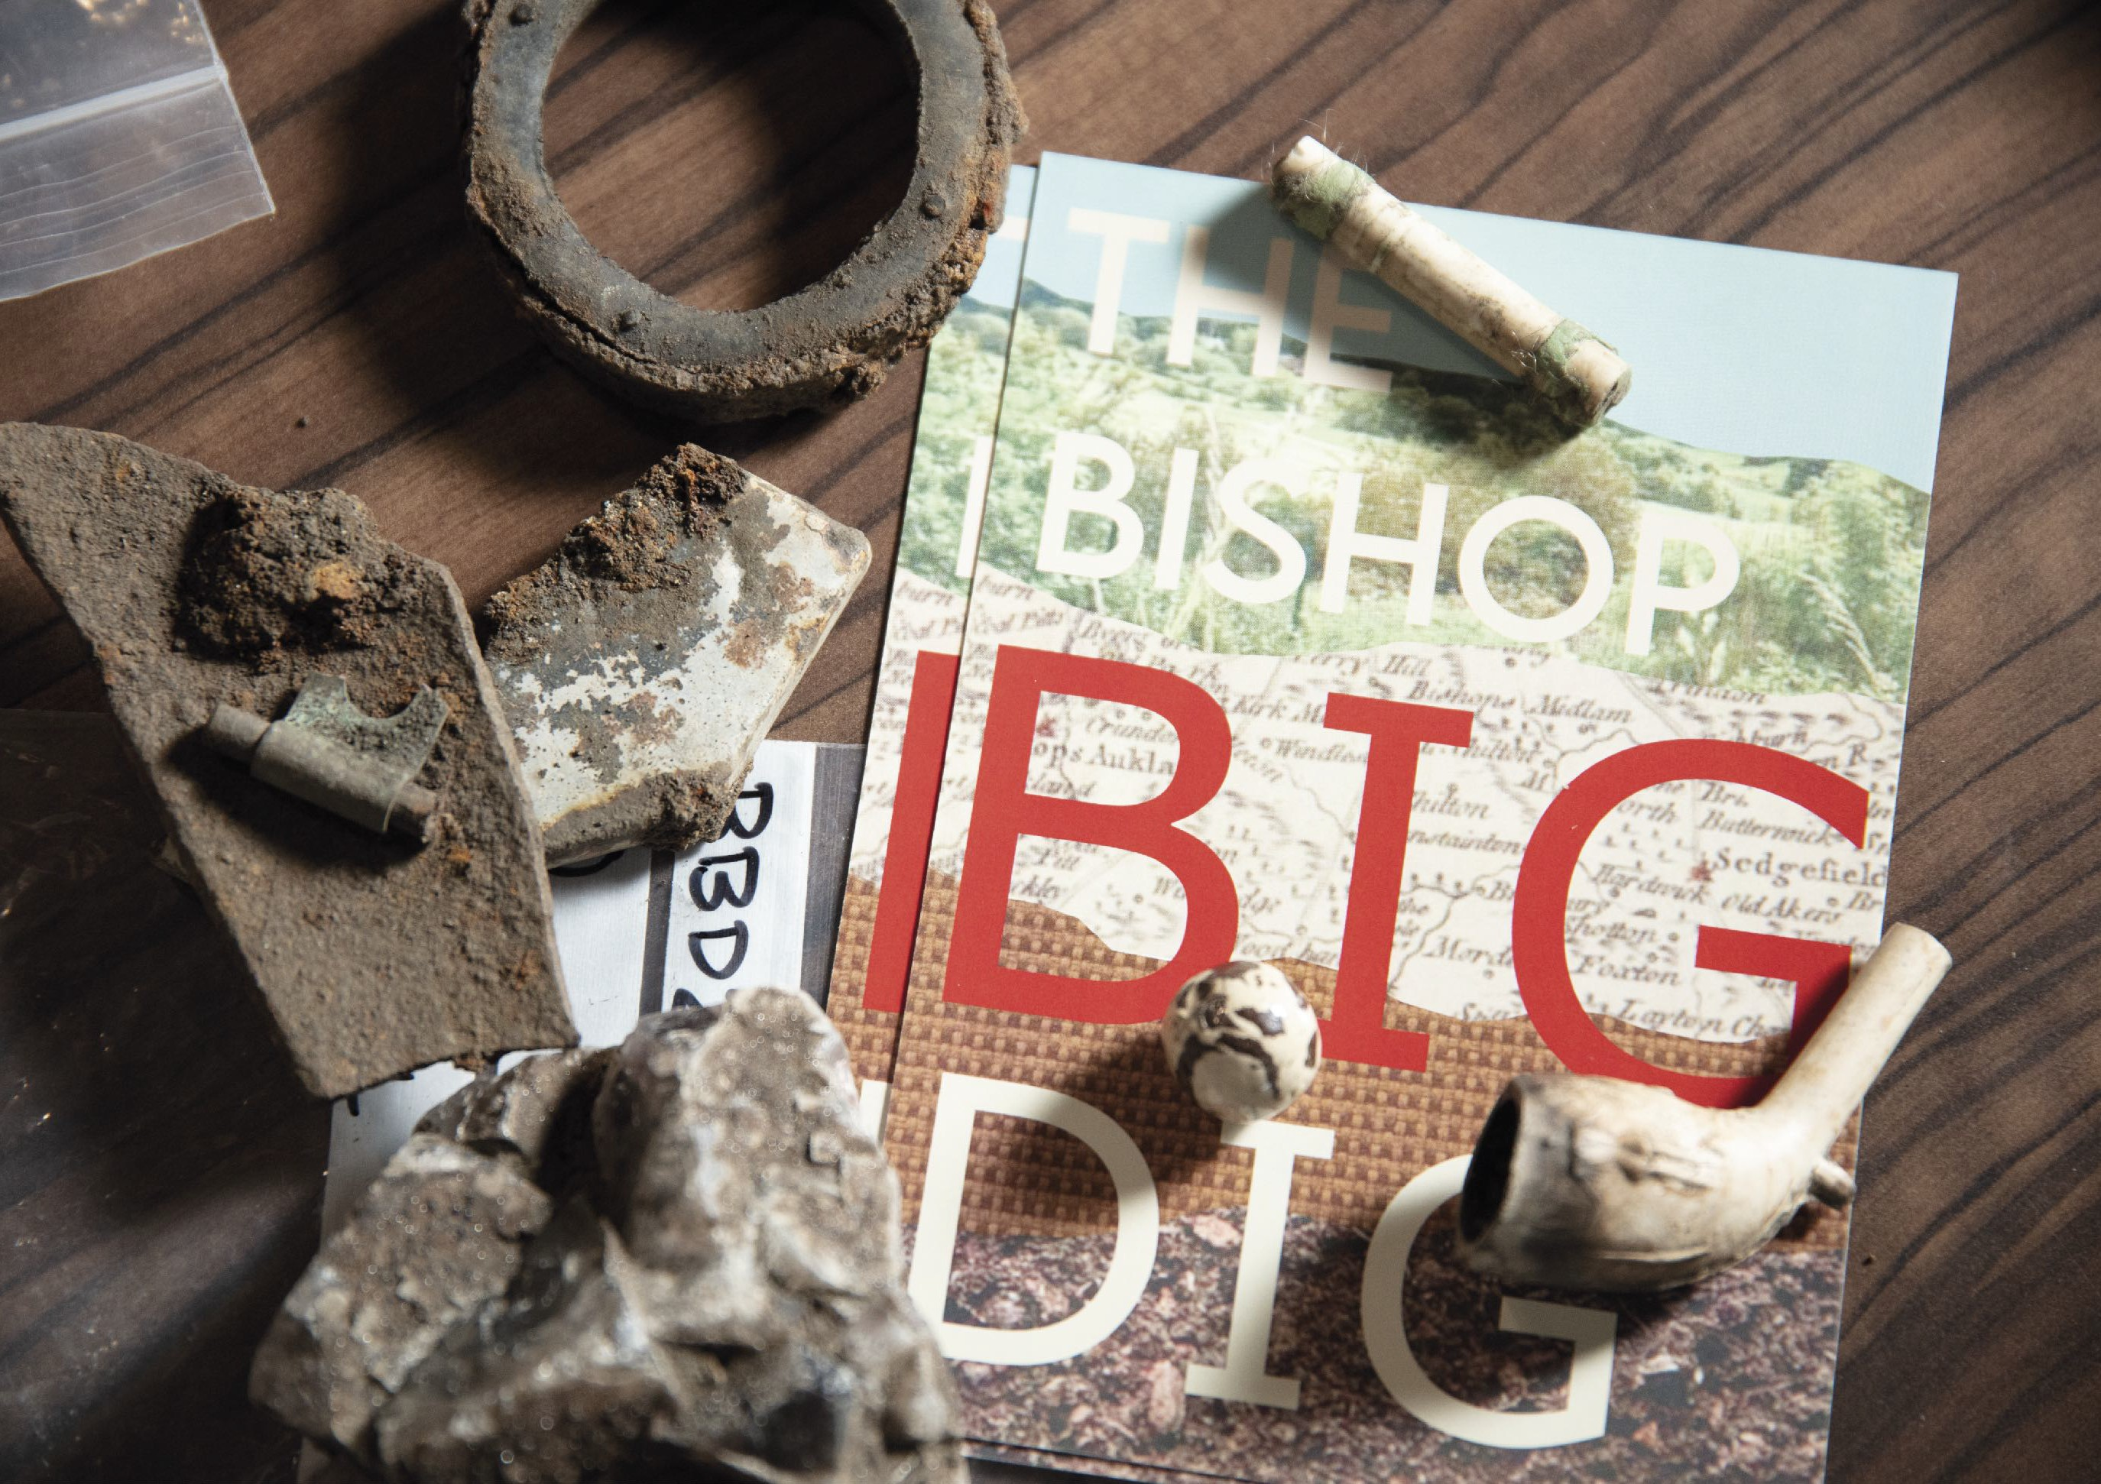

Slide 24
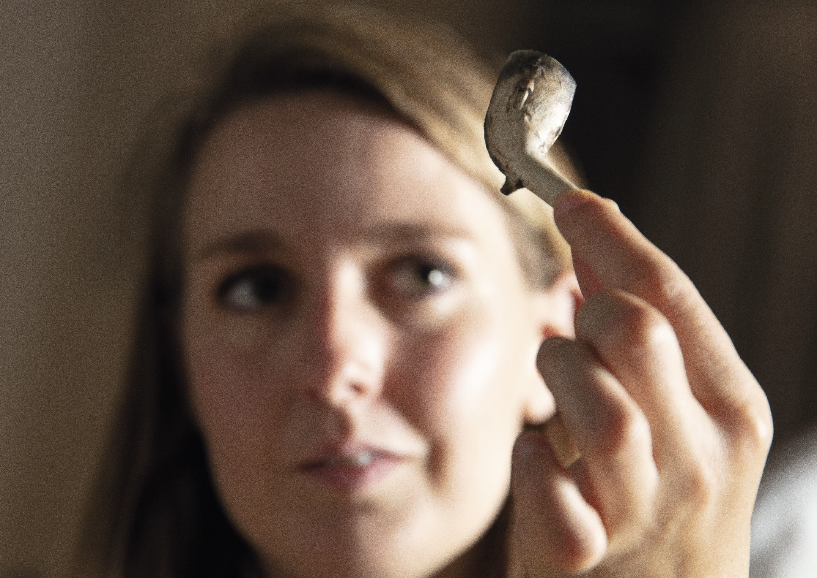
Archaeologist Caroline Smith with a clay pipe found in the Bishop Big Dig. © Andrew Heptinstall Photography.

Slide 25
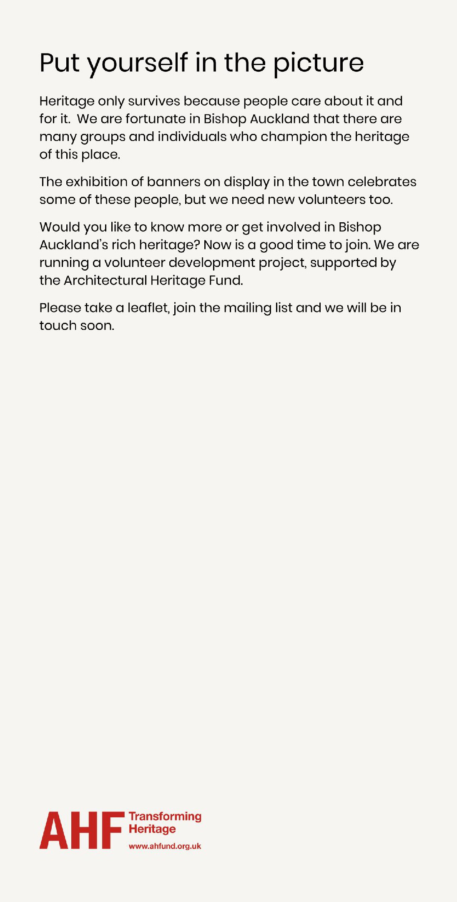
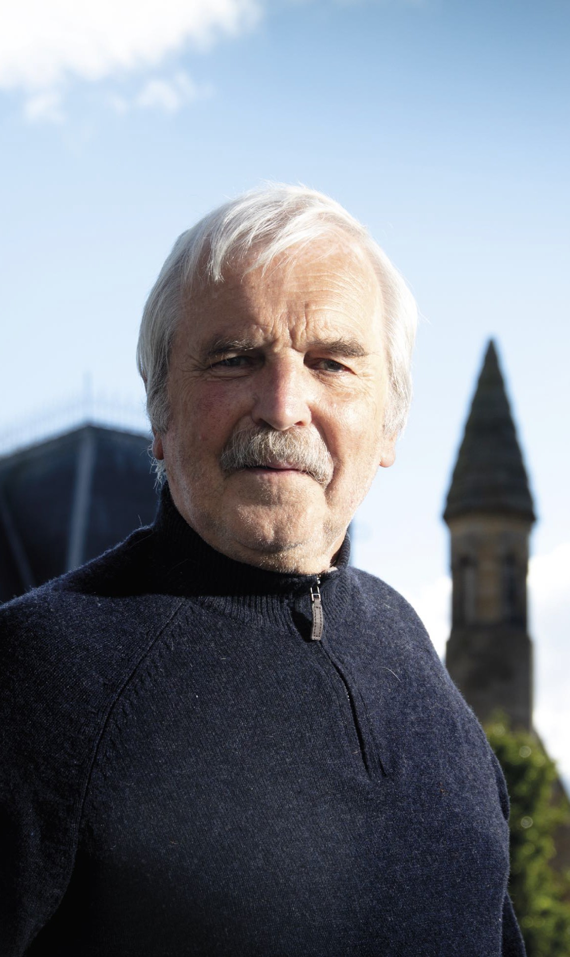
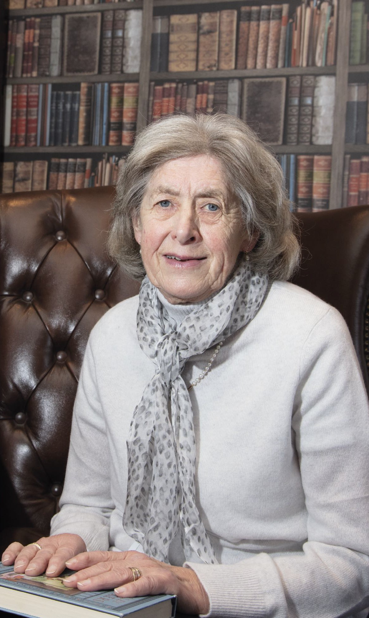
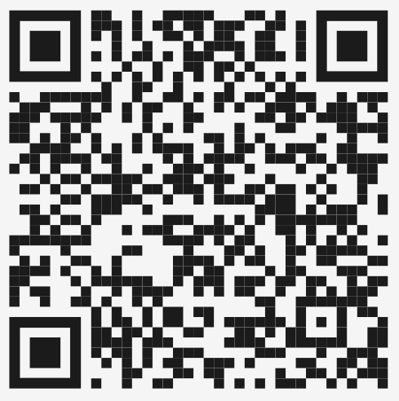
Chair of the Heritage Action Zone Advisory Group, Bob McManners led the campaign to save the Town Hall and the viaduct in the 1980s. The Civic Society grew out of this movement. He continues to champion investment in the historic town centre.
Retired headteacher Stefa McManners was awarded the MBE for her impact on local communities and is known for her tireless volunteering. She is a trustee of Eleven Arches, was instrumental in Kynren, and is passionate about the potential of people in Bishop Auckland who make the renaissance of the town possible.

Slide 26
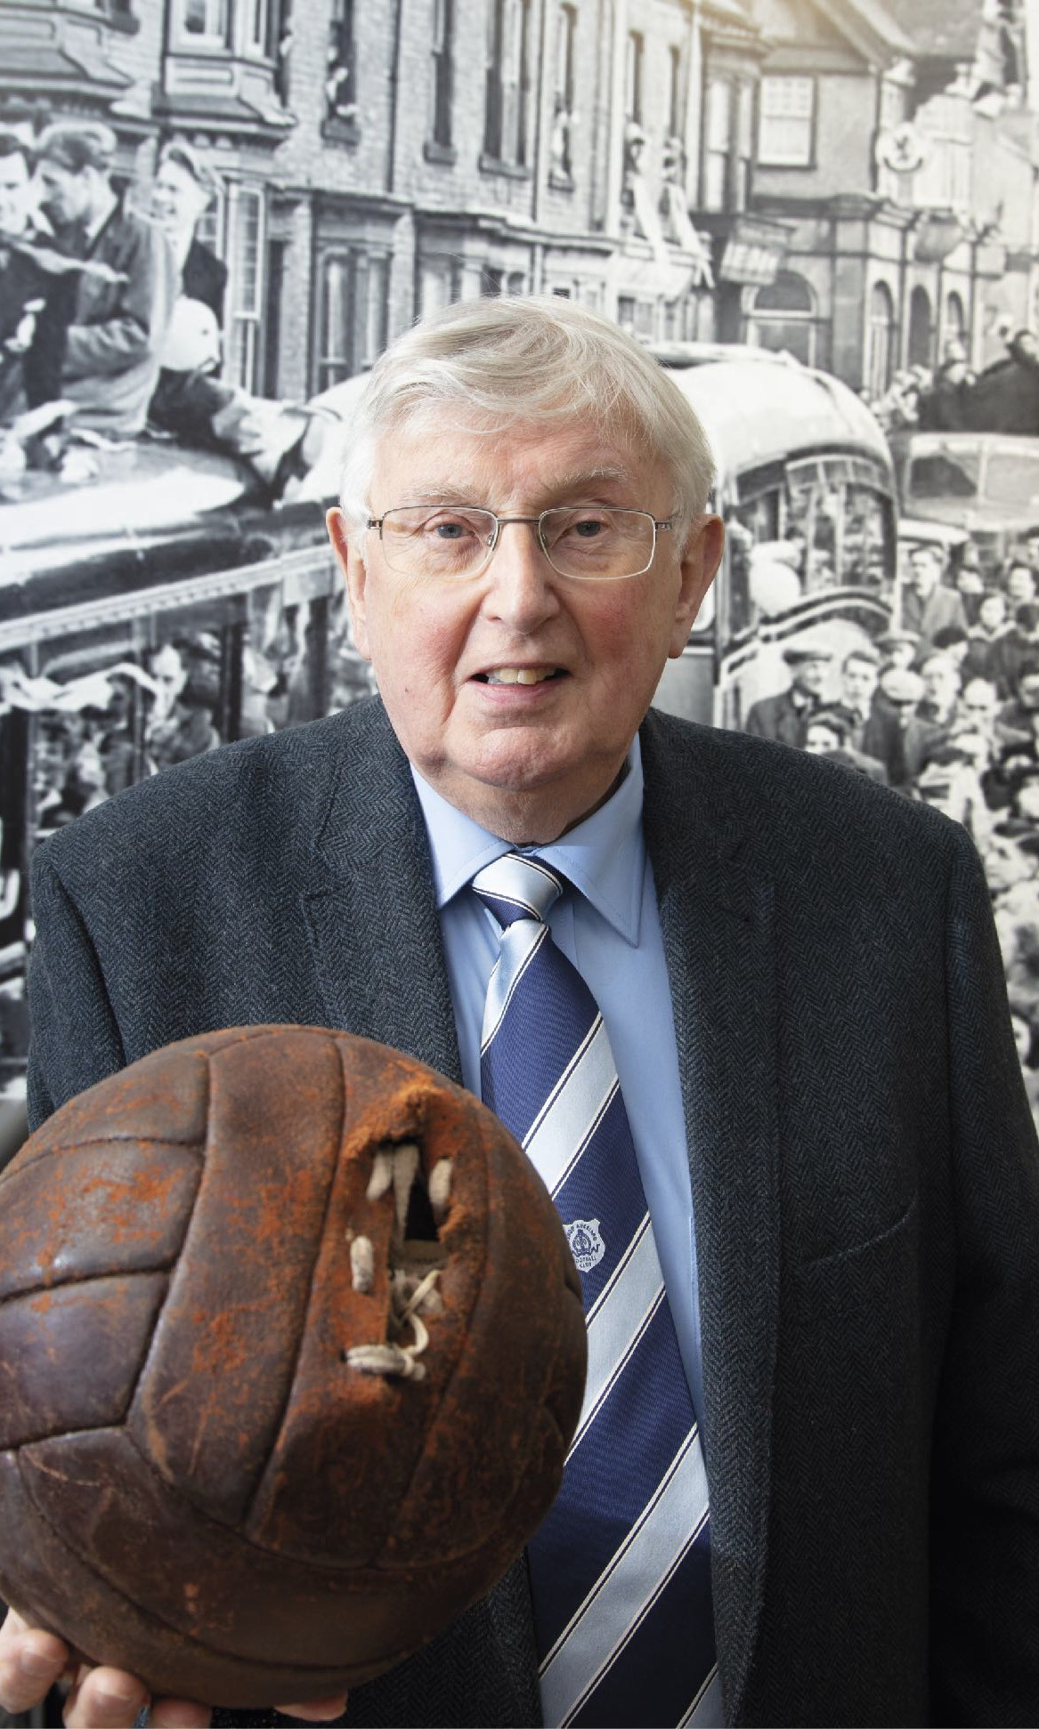
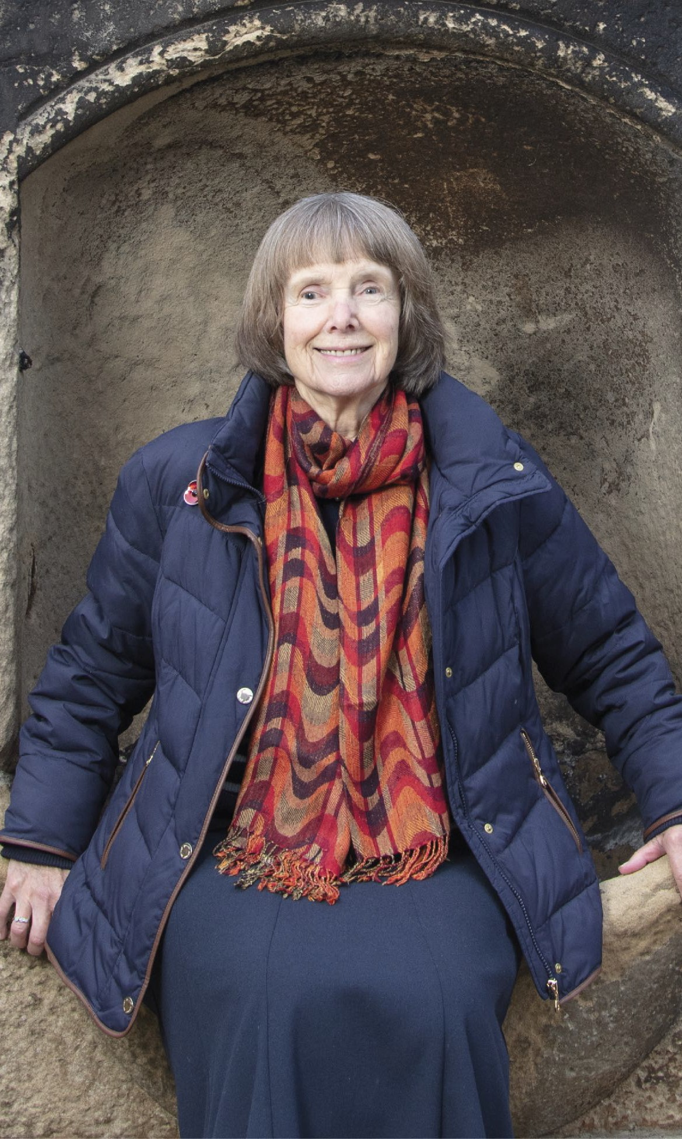
Dick Longstaff, secretary of Durham Amateur Football Trust, is daft about football and passing on sporting and social history.
Retirement for Barbara Laurie has been busy writing and editing heritage interpretation for the HAZ. Here she is pictured at the Victorian water trough, known as a ‘pant’, on High Bondgate, one of two that the Heritage Action Zone has restored.

Slide 27
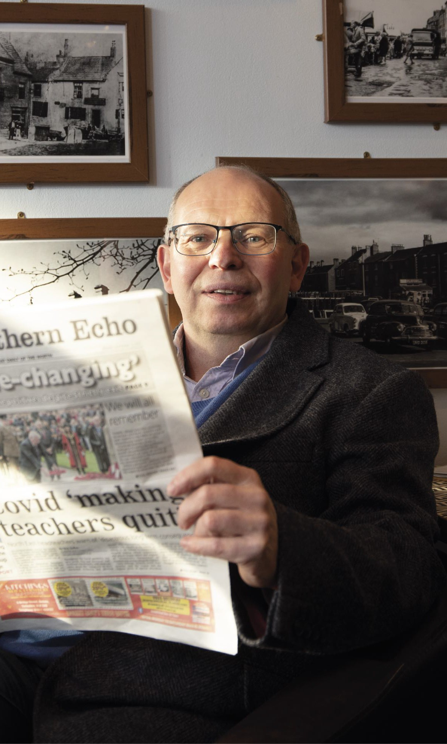
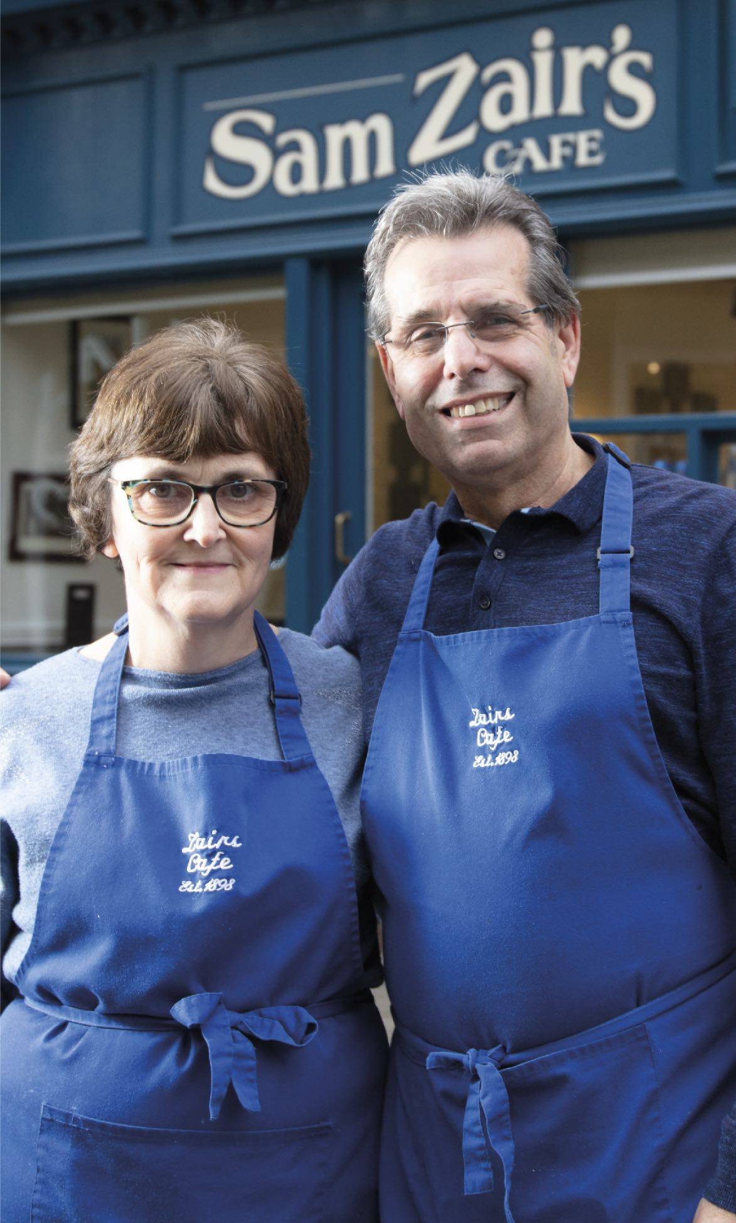
Readers of The Northern Echo may recognise Chris Lloyd. As author of the regular ‘Memories column’ there’s not much he doesn’t know about places and people of
the past.
Lesley and husband Sam Zair are the fifth generation of Zairs in Bishop Auckland. Sam Zair serves on the Heritage Action Zone Advisory Board and Lesley, Sam and son Adam serve on Bishop Auckland Town Council.

Slide 28
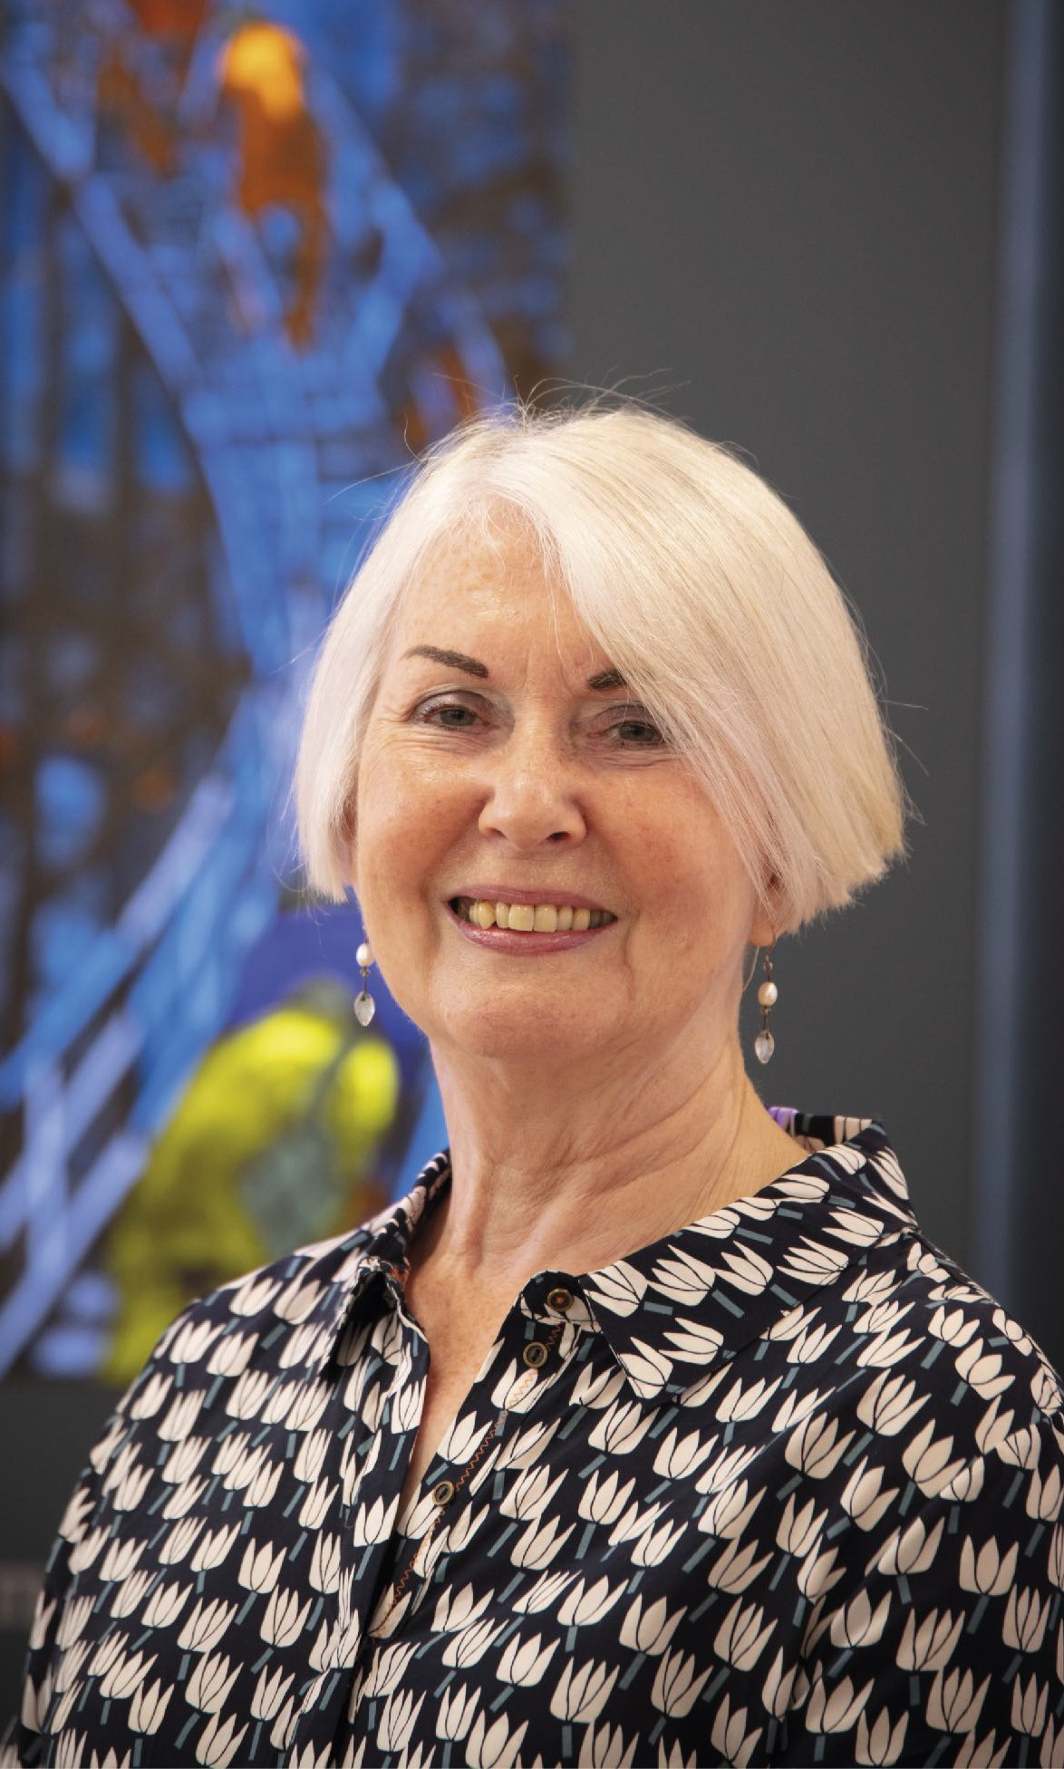
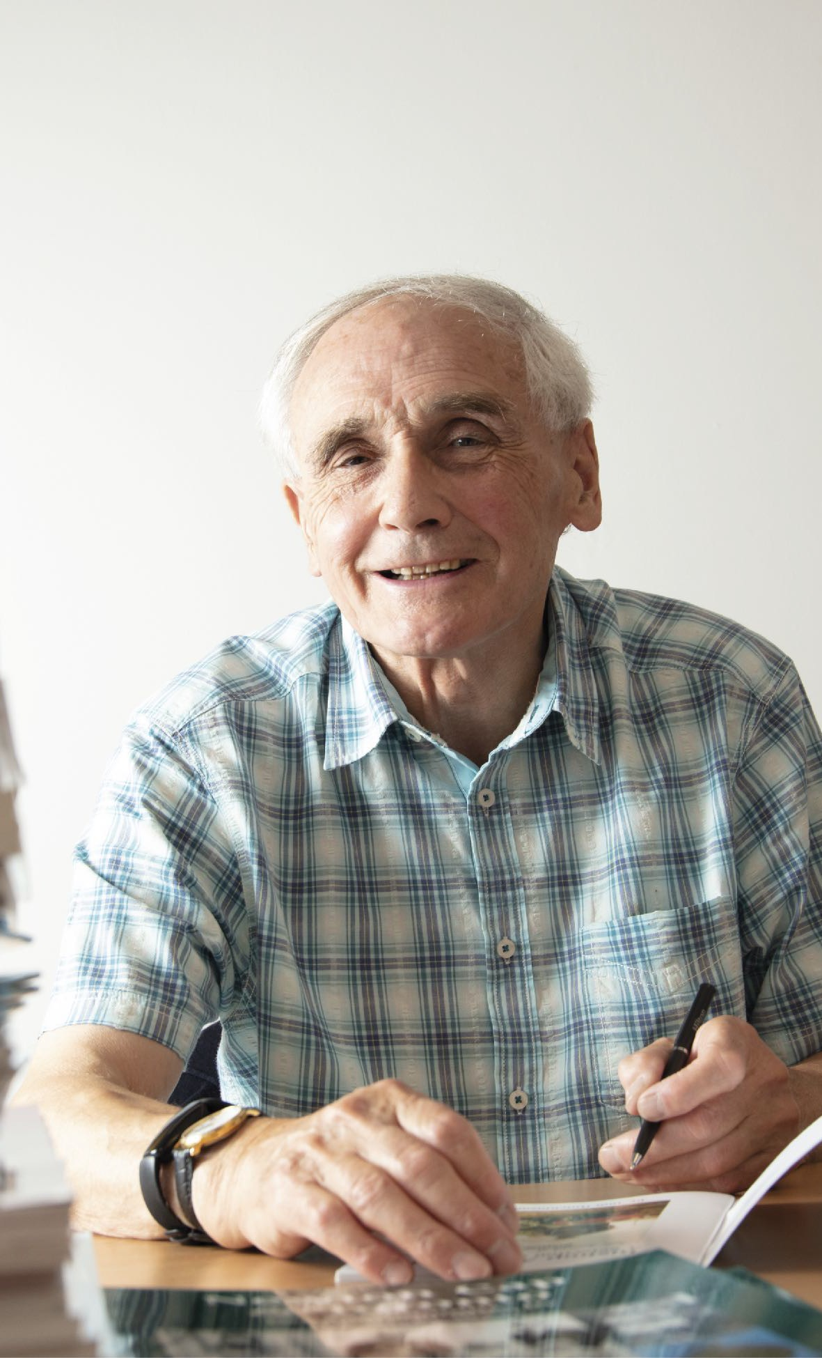
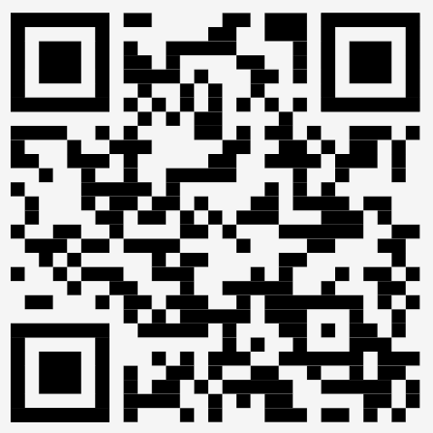
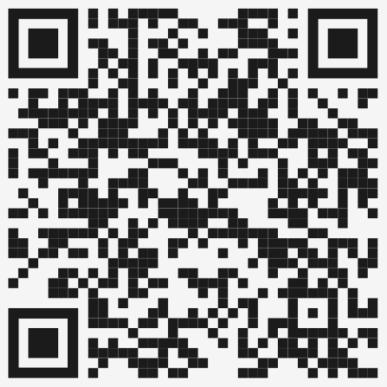
Responsible for the refurbishment of the Town Hall in the 1980s, Gillian Wales, has a passion for mining art. Here she talks about the establishment of the mining art collection.
Local historian Tom Hutchinson is well known for his books about Bishop Auckland. Here you can hear him talking about life ‘Down the Batts’.

Slide 29
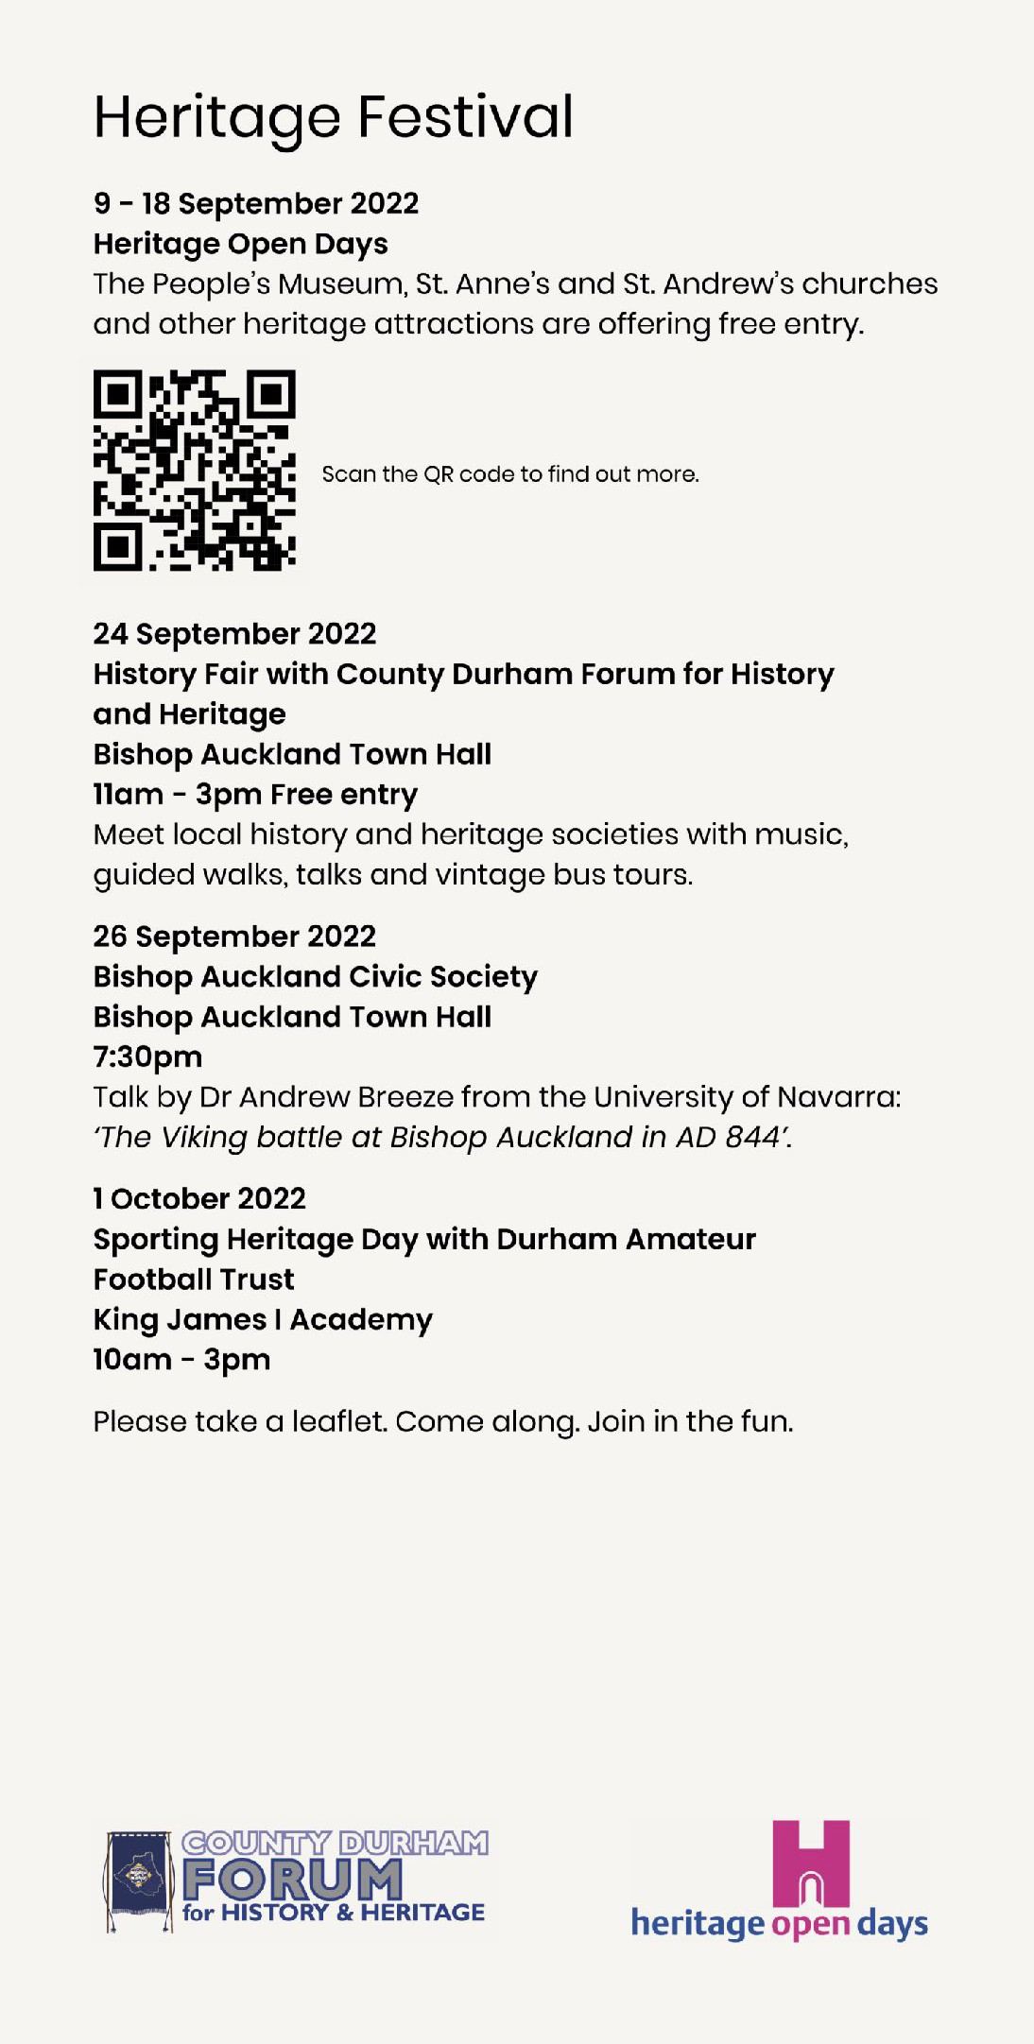
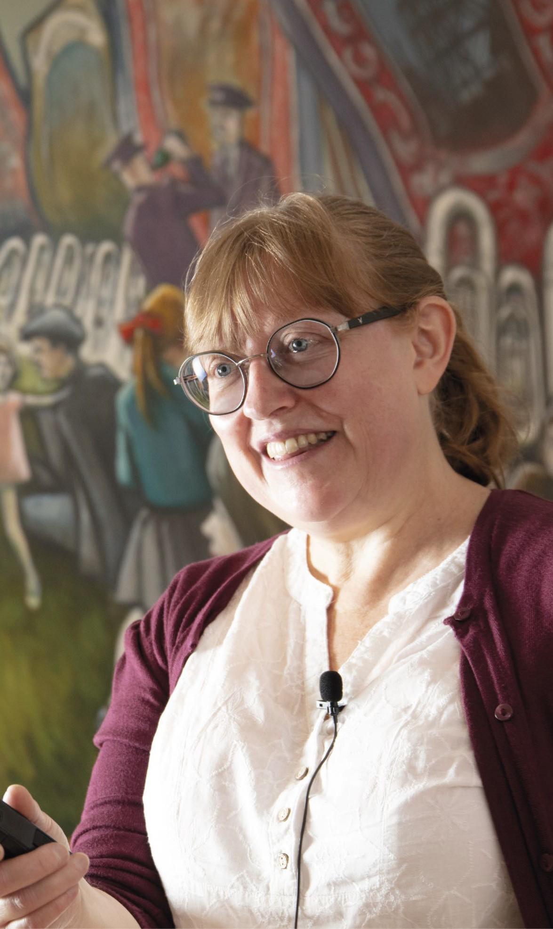
‘Bishop FM will continue to help organise the
Heritage Festival
in future years’
A volunteer with Bishop FM radio, Gillian Campbell has played a key role in promoting the annual Heritage Festival to a wider audience.

Slide 30
Portrait photography by Andrew Heptinstall
Exhibition design by Red Square Design

